Slide 1
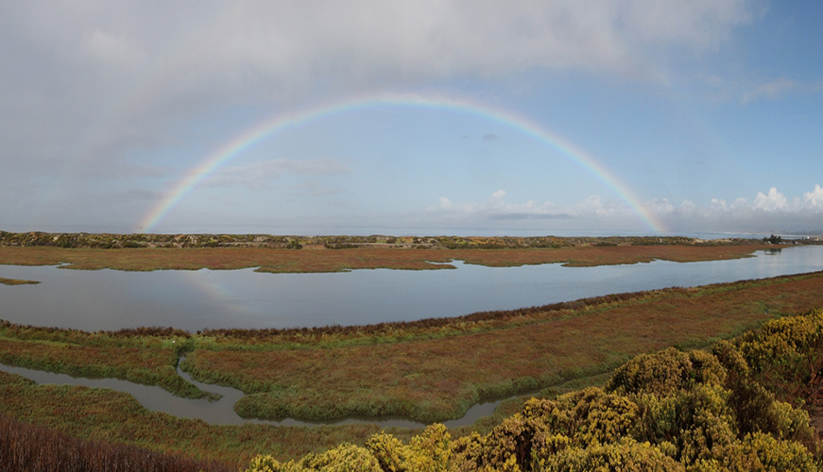



Programmable Flow Injection Ocean Nutrient Analyzer
(pFIONA)
ME195B
Andrew Silva, Timothy Ly, Tracy Hunter
Instructor: Ed Cydzik
Mechanical Engineering Department
San Josė State University
May 13, 2022

Slide 2
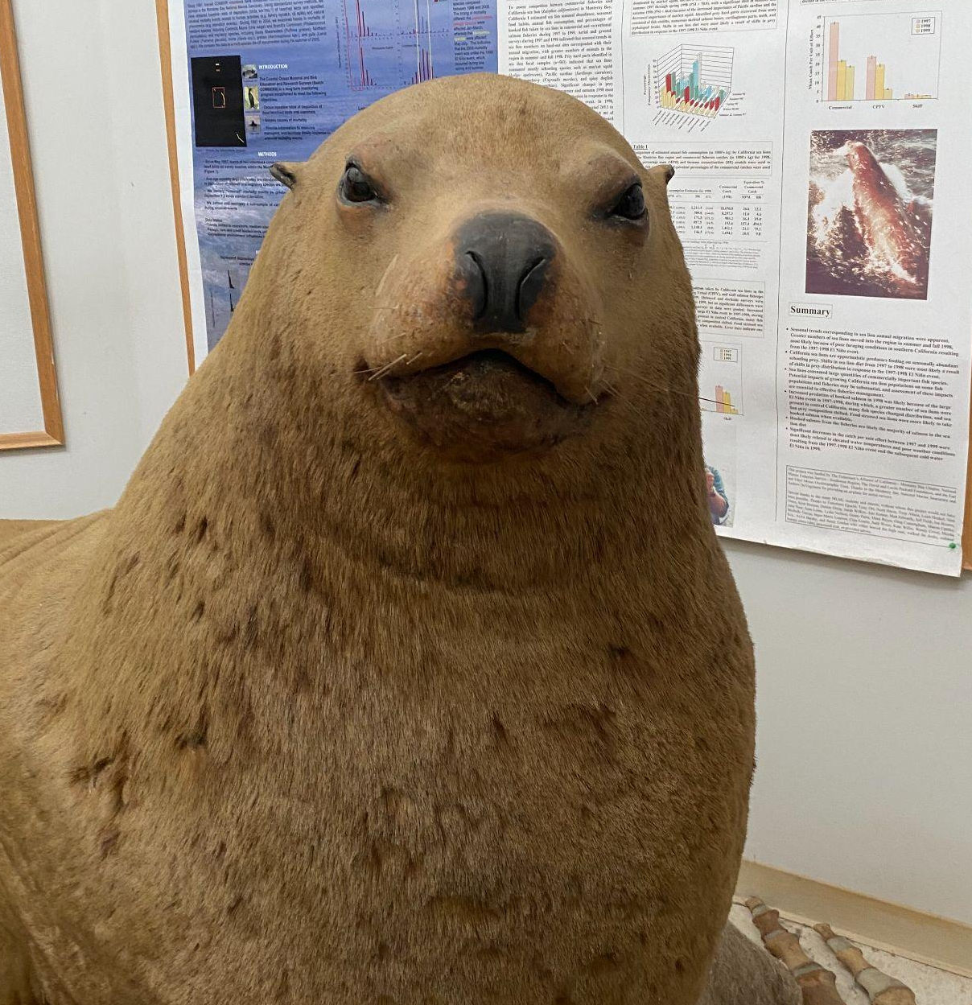
What Will Be Covered
Andrew Silva
Motivations
Literature Review
Objectives & Specifications
Design and Methodologies
Results
Conclusion
Future Work

Slide 3
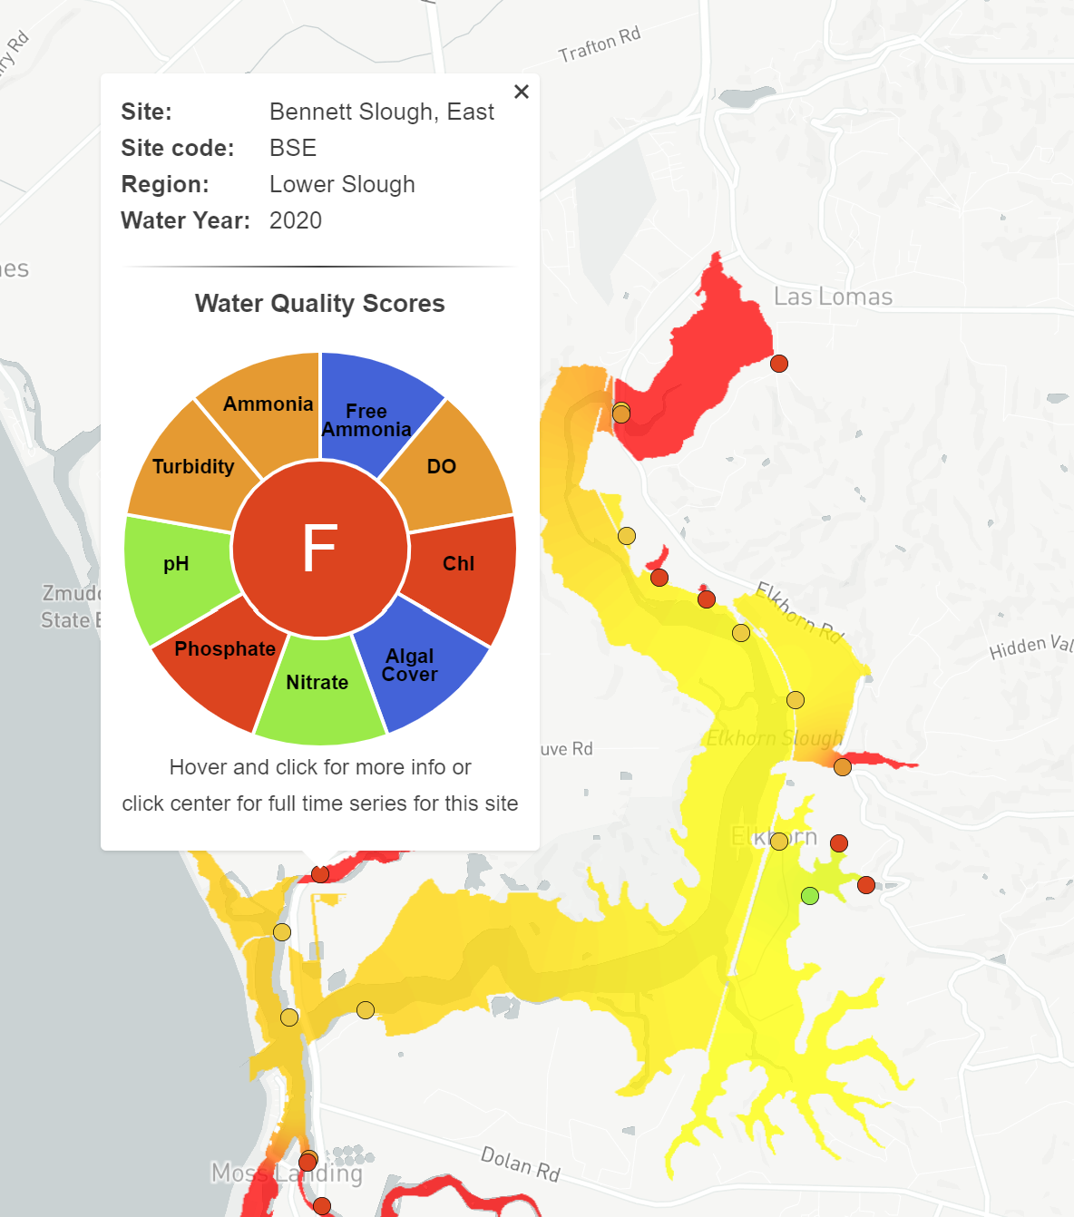
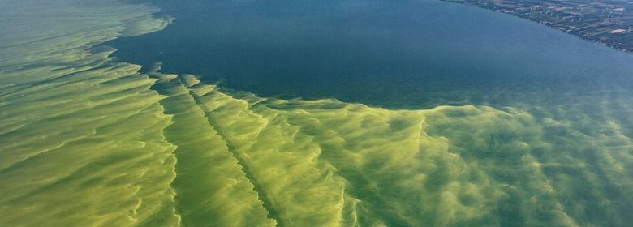
What do Flow Injection Analysis (FIA) Nutrient Analyzers do?
Tim Ly
Keeps an eye on water nutrient levels to monitor for eutrophication
Uses spectrophotometry to measure absorbance of a chemically mixed sample
Obtains the concentration of nutrients in a sample based on measured absorbance
Water Quality score of Bennett Slough in 2020 which runs into Moss Landing Beach. Elkhorn Slough
Algae bloom in Monterey County. March 18, 2020.co.monterey.ca.us. https://www.co.monterey.ca.us/government/departments-a-h/health/environmental-health/general/public-beaches-water-quality/harmful-algal-bloom

Slide 4
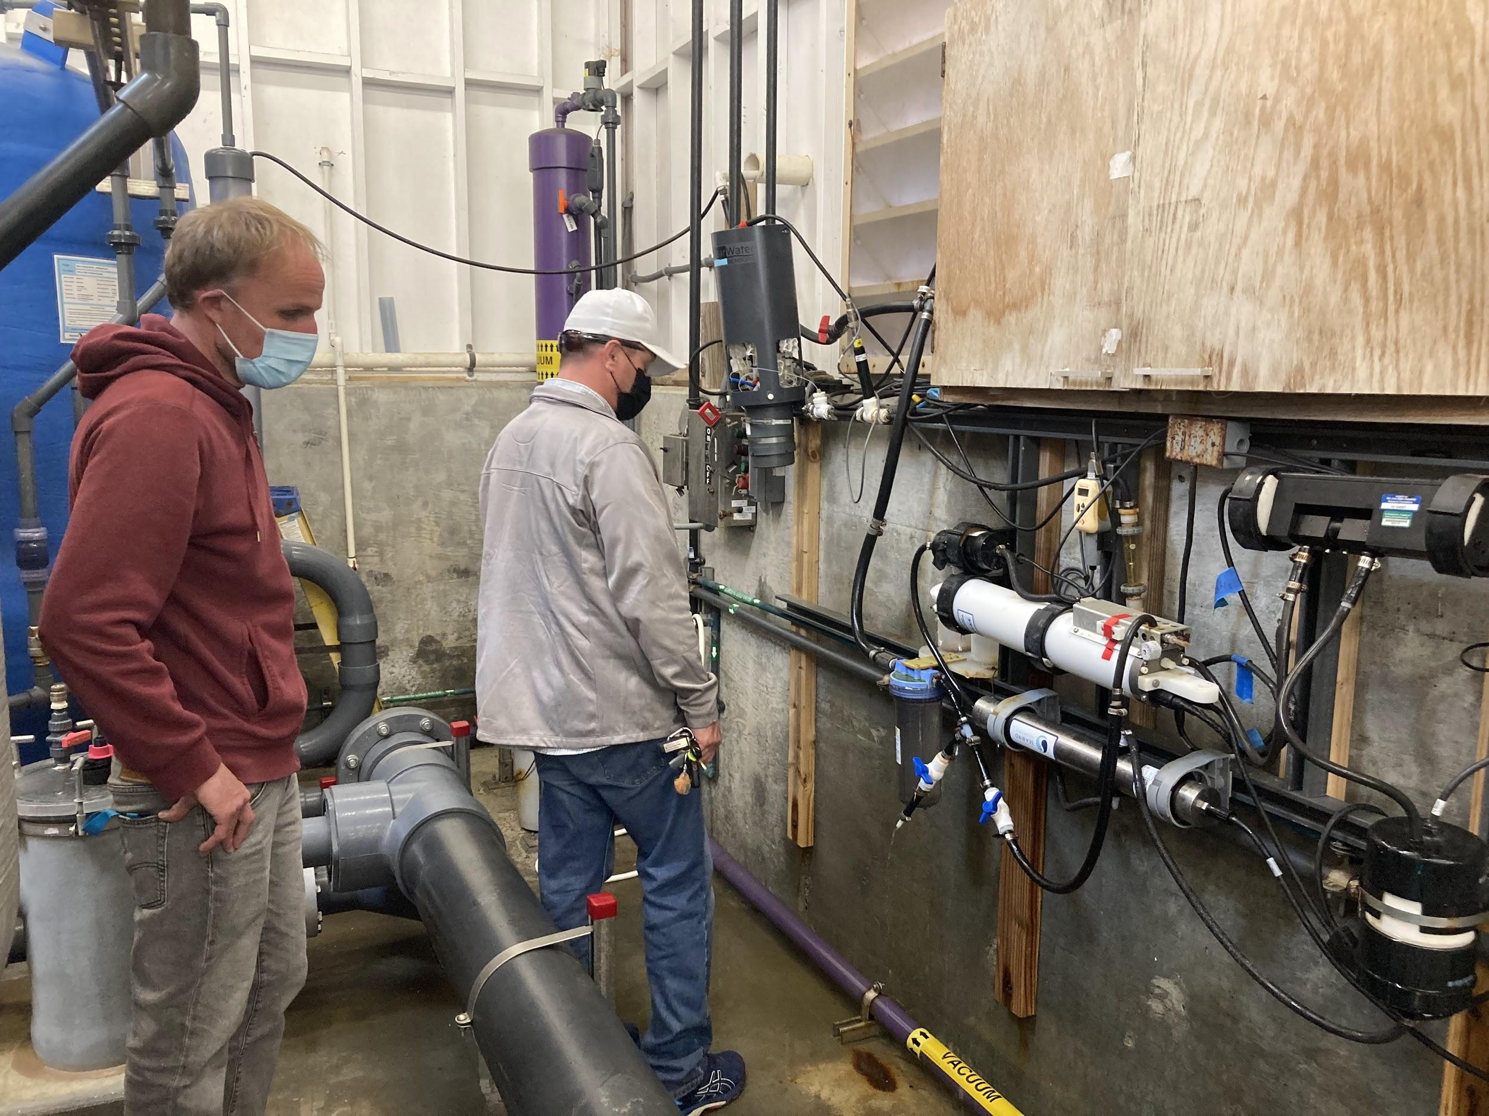
Research
Andrew Silva
Majority of Initial research was into the actual chemical assay that was to be automated. An in-depth understanding of the chemistry was not required but a high level understanding was required in order to develop the instrument and interface with the users of it.
Understanding of the principles of spectrophotometry
How Why Data collected and how its used

Slide 5
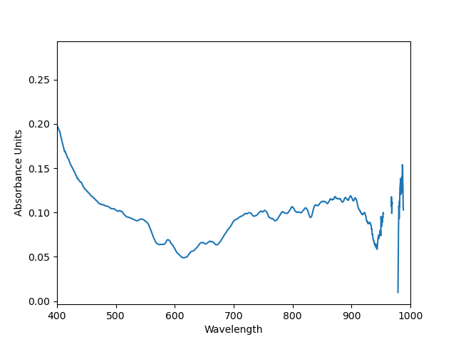
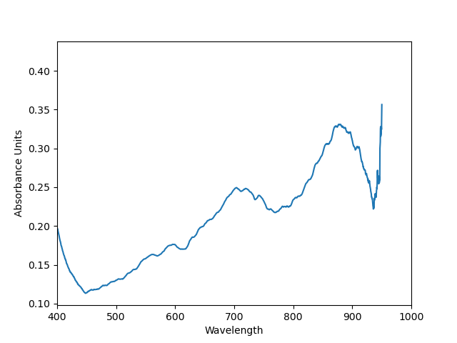
What is Flow Injection Analysis (FIA)?
Tim Ly
Fluid Analysis Method
“FIA manifold used in a theoretical hydrodynamic study involving the injection of a dye. At the bottom is the profile exhibited by the dye plug in its way from the injection point to the detector. The result is an asymmetric peak exhibiting a χ2 type distribution. The height and area of the peak are proportional to the concentration of the target species, which facilitates the construction of a calibration curve for its determination in unknown samples”
Efficient & Precise
.3mm tubing
uLs of fluid
Quick
Faster chemical reaction times
Notes:
FIA manifold used in a theoretical hydrodynamic study involving the injection of a dye. At the bottom is the profile exhibited by the dye plug in its way from the injection point to the detector. The result is an asymmetric peak exhibiting a χ2 type distribution. The height and area of the peak are proportional to the concentration of the target species, which facilitates the construction of a calibration curve for its determination in unknown samples

Slide 6
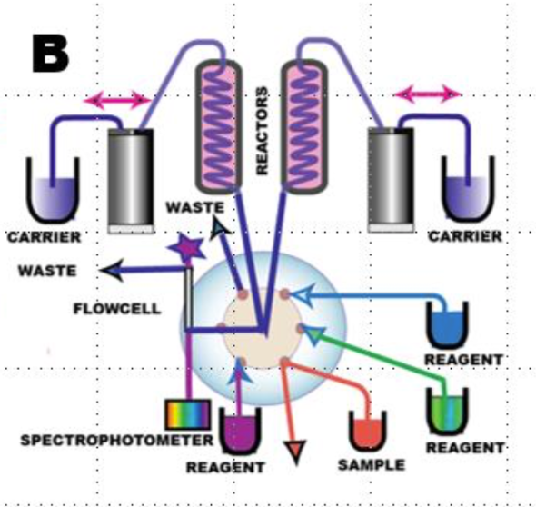
What’s in FIA?
Tim Ly
Propulsion
milligat pumps
pushes/pulls fluid
high resolution
Injection
rotary valve
controls piping of chemicals
Separation/Mixing
PFTE coils
unreactive, coils induce radial mixing
Detection
data collection

Slide 7
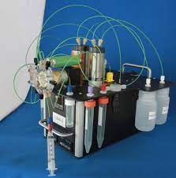
Benchtop Nutrient Analyzers
Tim Ly
Companies like GlobalFIA produce bench top, Windows dependent machines with proprietary software
Machines such as the miniSIA2 Cost around $30,000
Deployment spaces of these instruments are limited
Heavy
Piping
Not water resistant
Minisia 2
GlobalFIA.com

Slide 8
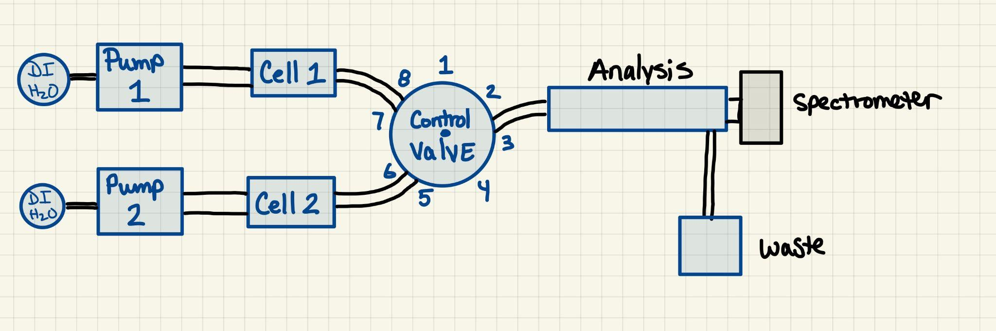
The Mechanics Of Data Collection
Tracy Hunter
Step 1: acquire base reference from spectrometer
Step 2 : pump 1 aspirates Ascorbic Acid into cell 1
Step 5: pump 1 dispenses sample into analysis chamber to determine absorbance
Step 3 : pump 1 dispenses Ascorbic Acid into cell 2
while pump 2 aspirates Molybdate into cell 2
Step 6: Flush system
Step 4 : pump 1 aspirates sample into cell 1 while pump 2
dispenses Ascorbic Acid/Molybdate into cell 1

Slide 9
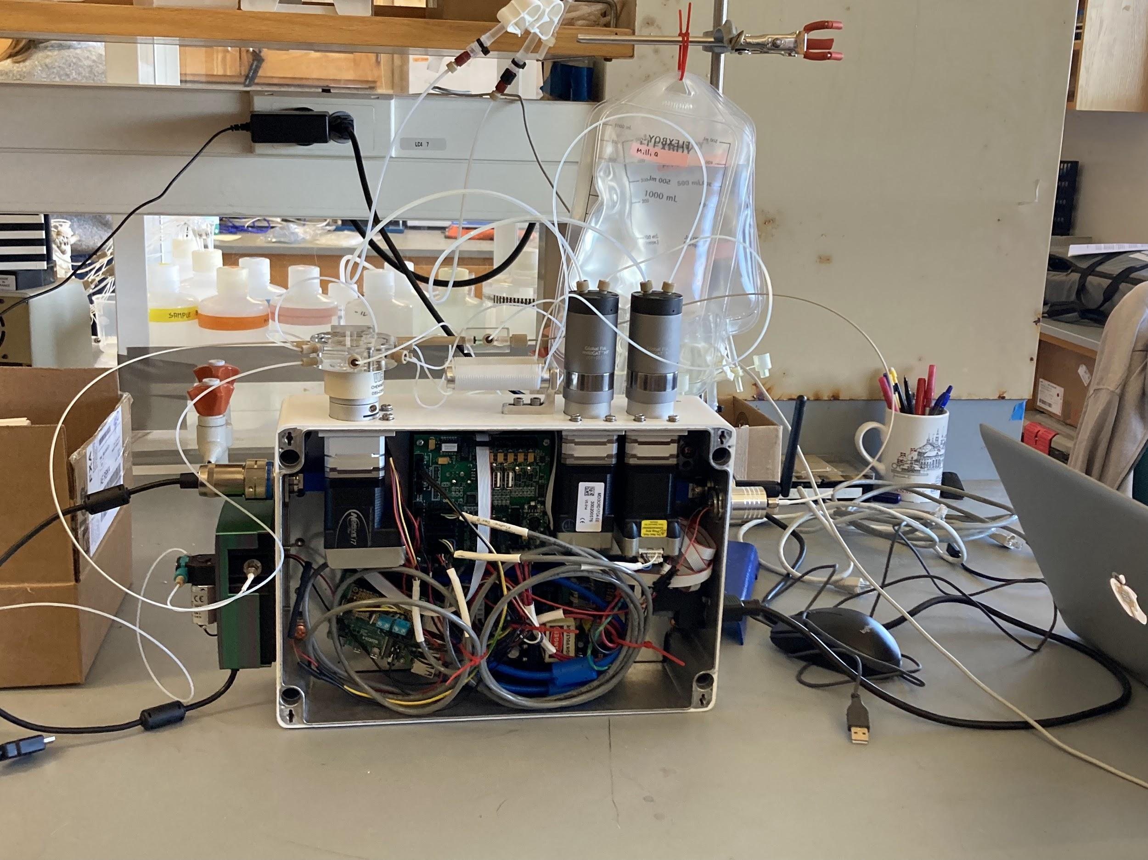
Meet pFiona
Tim Ly
Autonomous data collection
Wireless, automated
Deployable
Compact, no pc connection required
waterproof casing
Democratized
Removes need for expensive proprietary software
Cut costs of manufacturing

Slide 10
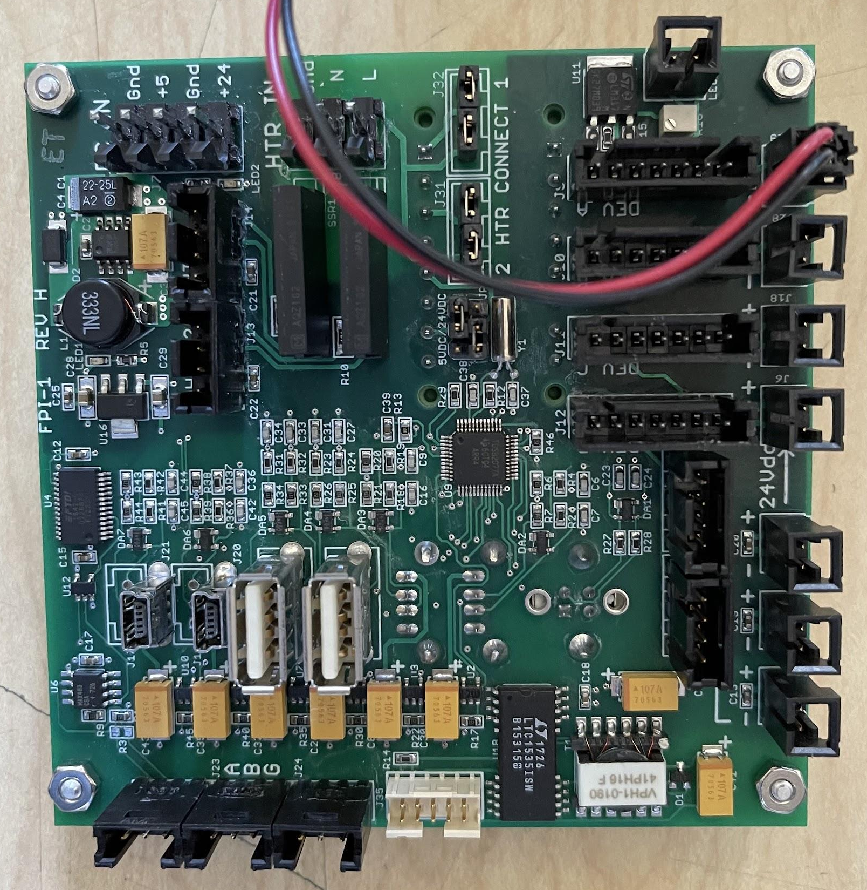
Firmware Development
Andrew Silva
“Black Box” Communication Board
Serial to RS485 communication conversion
M0Dbus Network for the Mdrives
Python Libraries:
PySerial, Miniterm,
Learned to reset the base programming on the Mdrives’ build-in controllers using terminal applications.
Notes:
A main hurdle of this project was utilizing the communication board provided by the sponsor. This comm. board is designed to be used through proprietary windows based software offered by it’s manufacturer. The software and board is over $10k from the price tag of the components used. Documentation was unavailable for the comm. board, because of this data sheets were collected for the integrated circuit visible on the printed circuit board. Only after reading through each of the IC’s documentation could we start researching into methods of control with the communication standards in use.

Slide 11
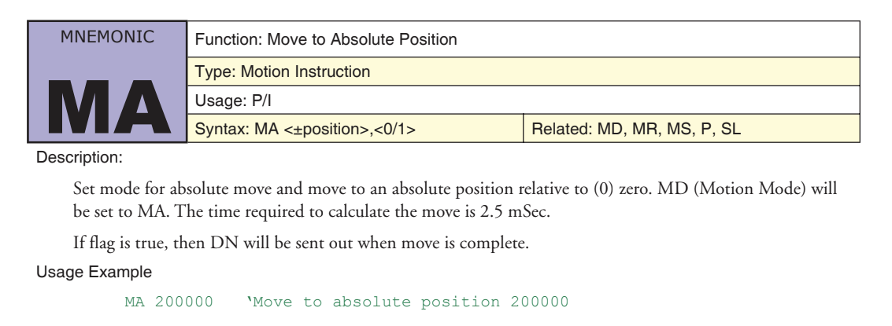
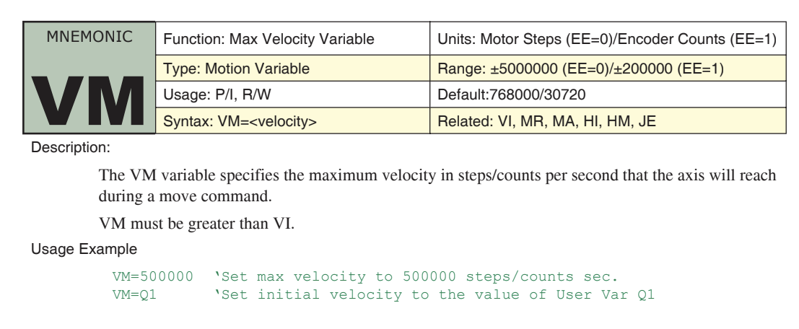
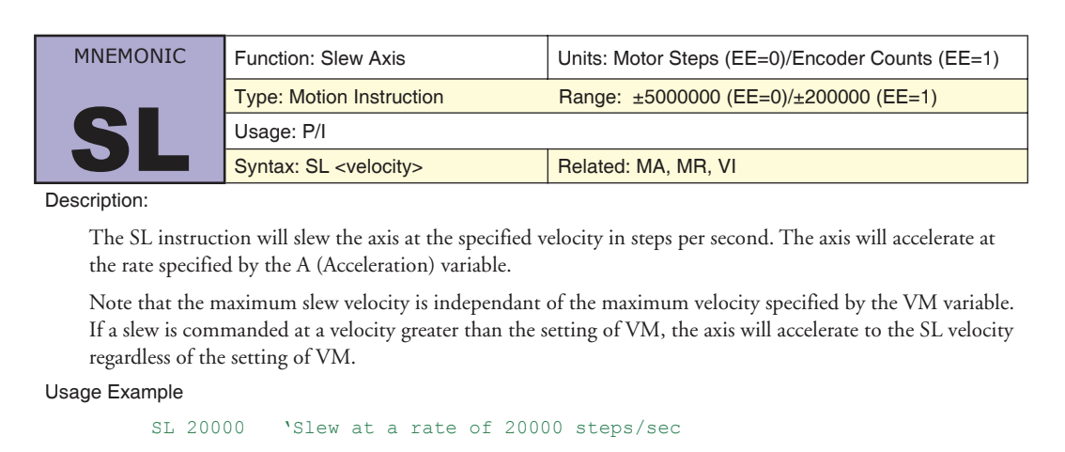
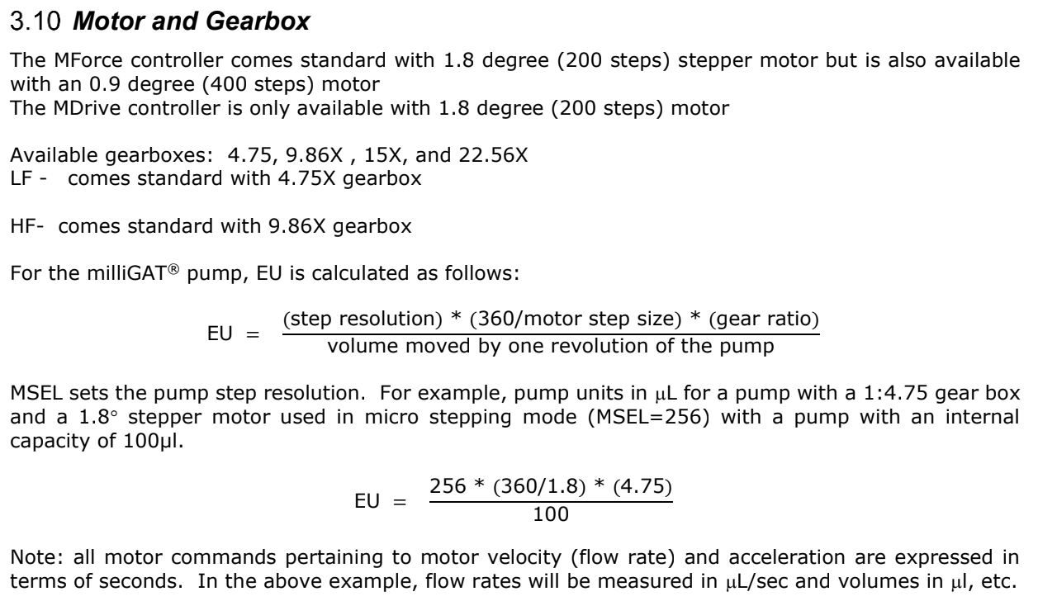
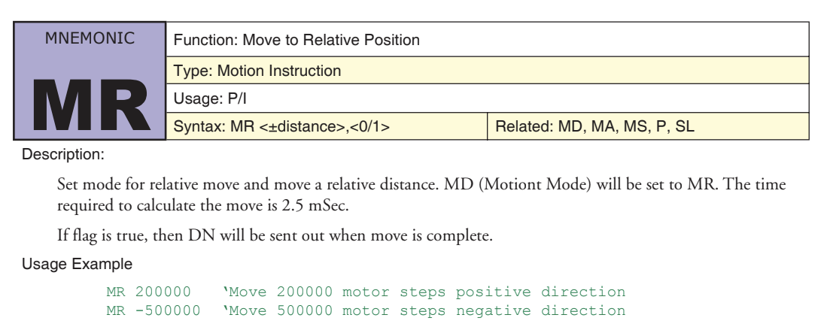
Understanding the language
Andrew Silva

Slide 12
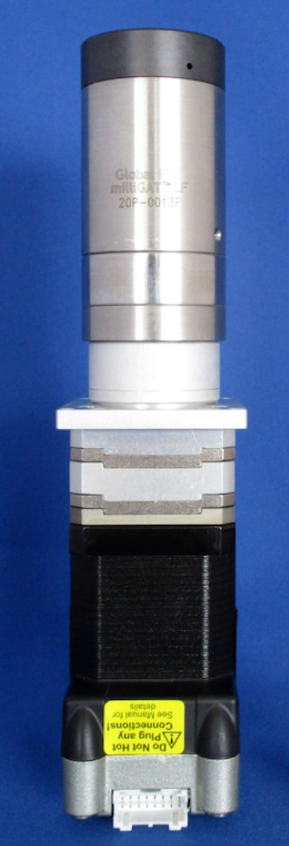
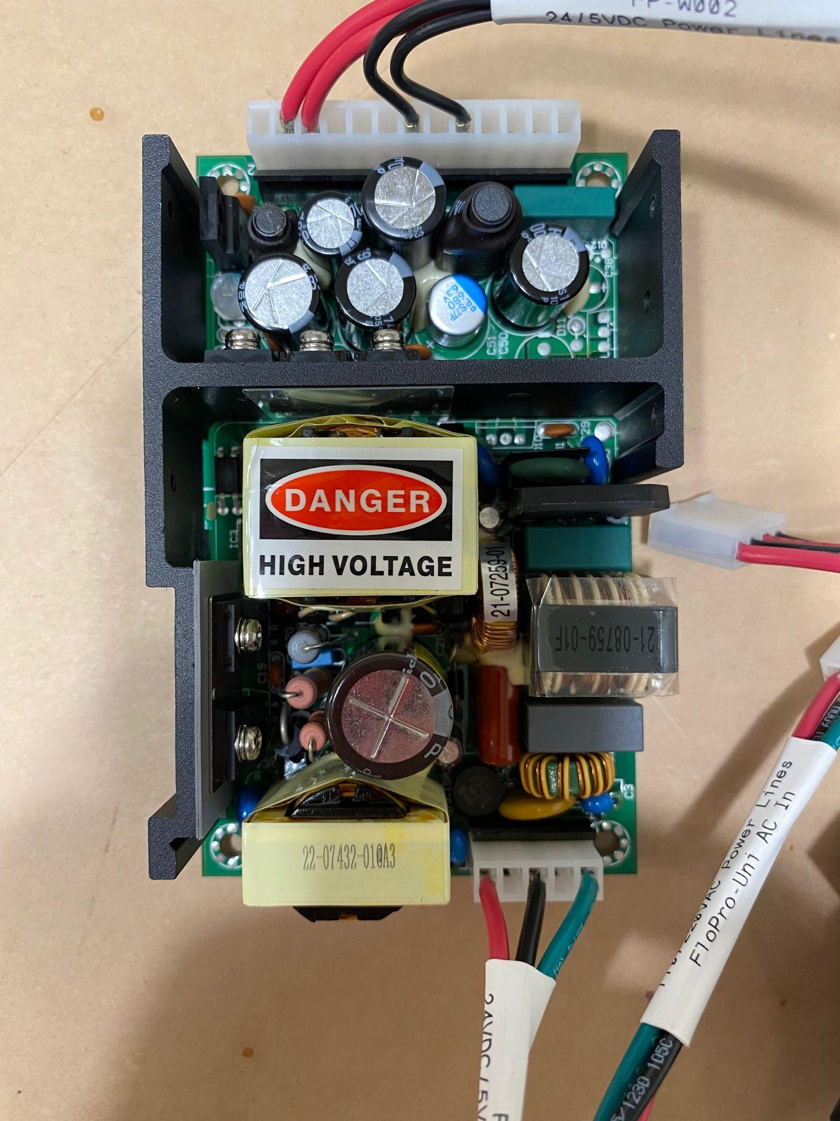
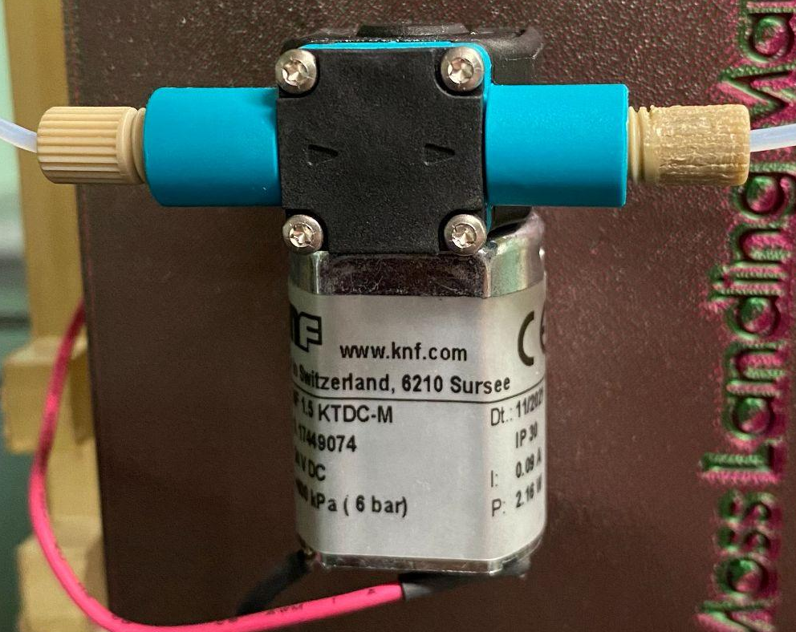
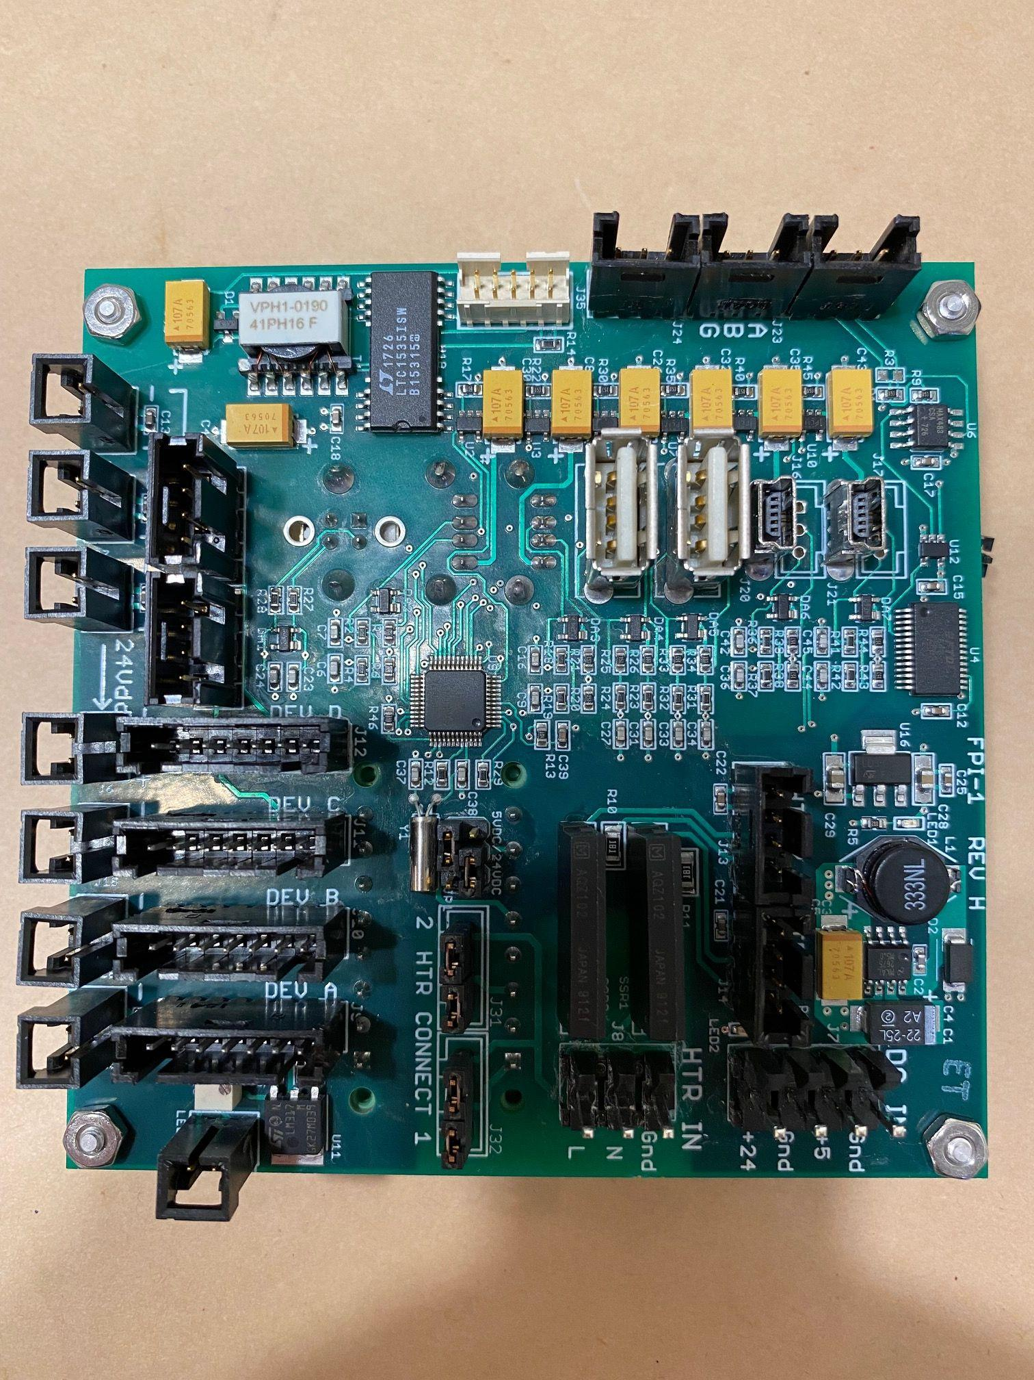
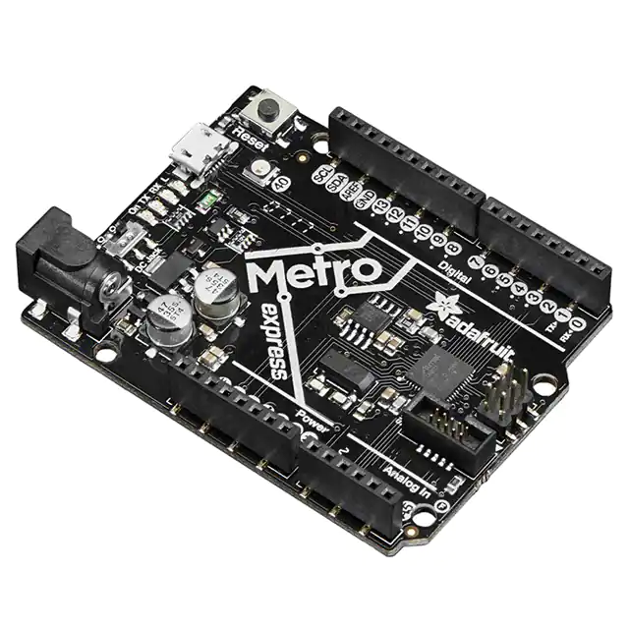
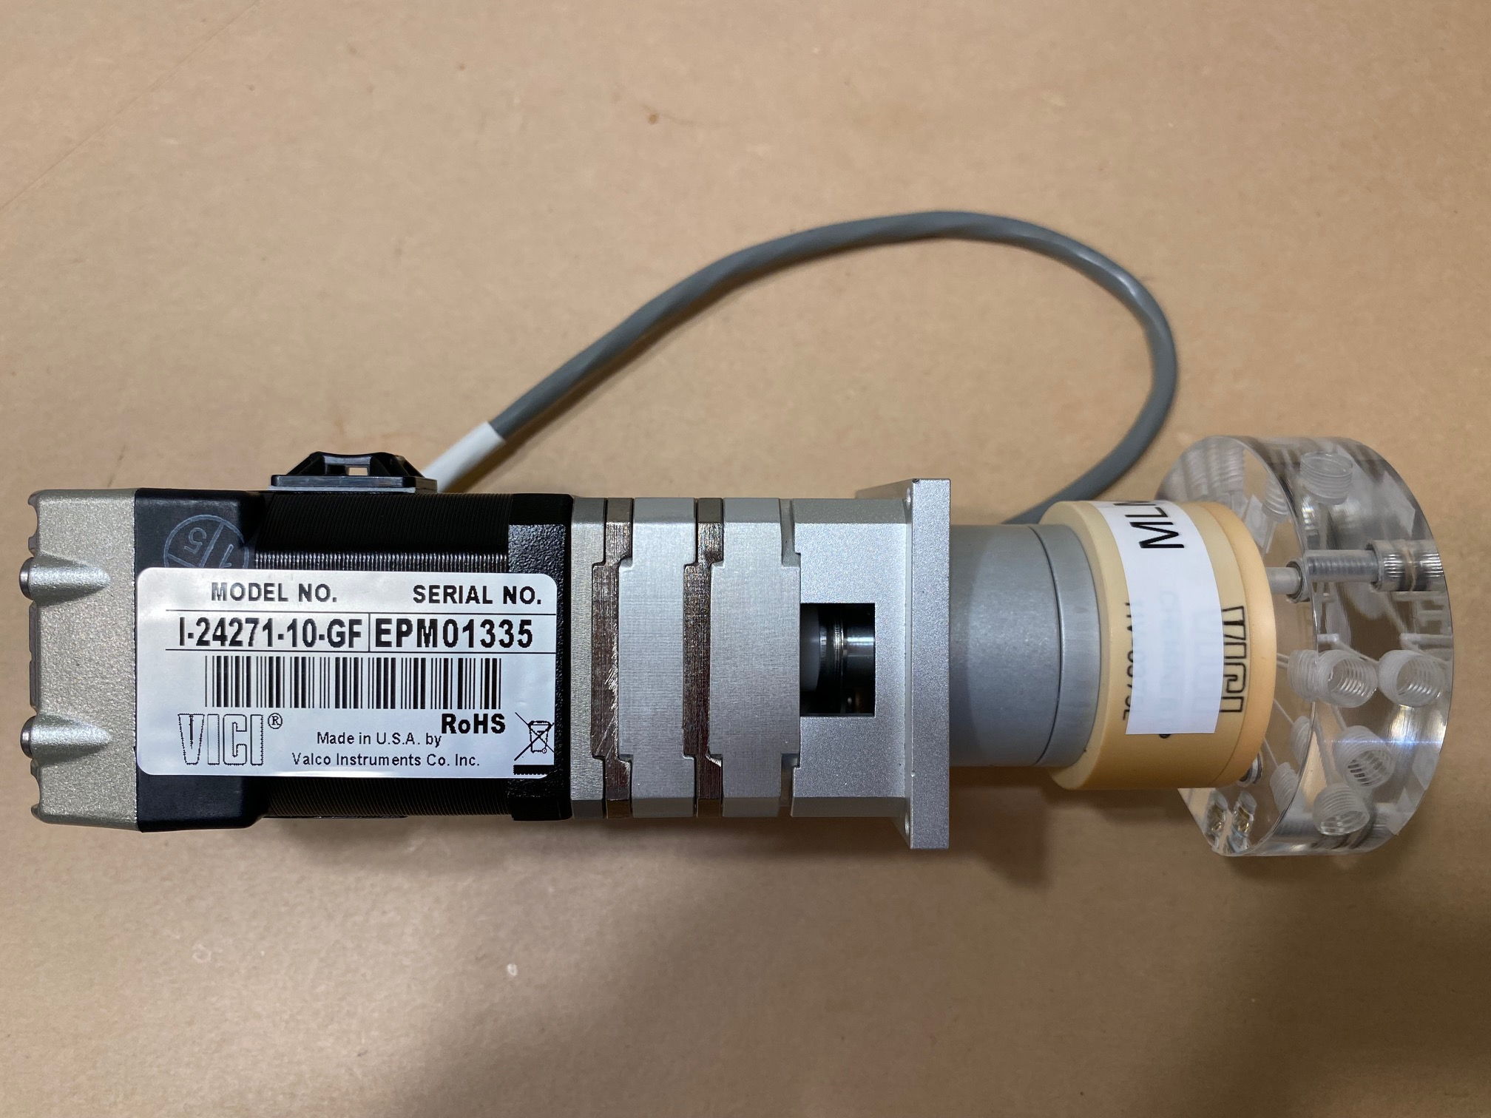
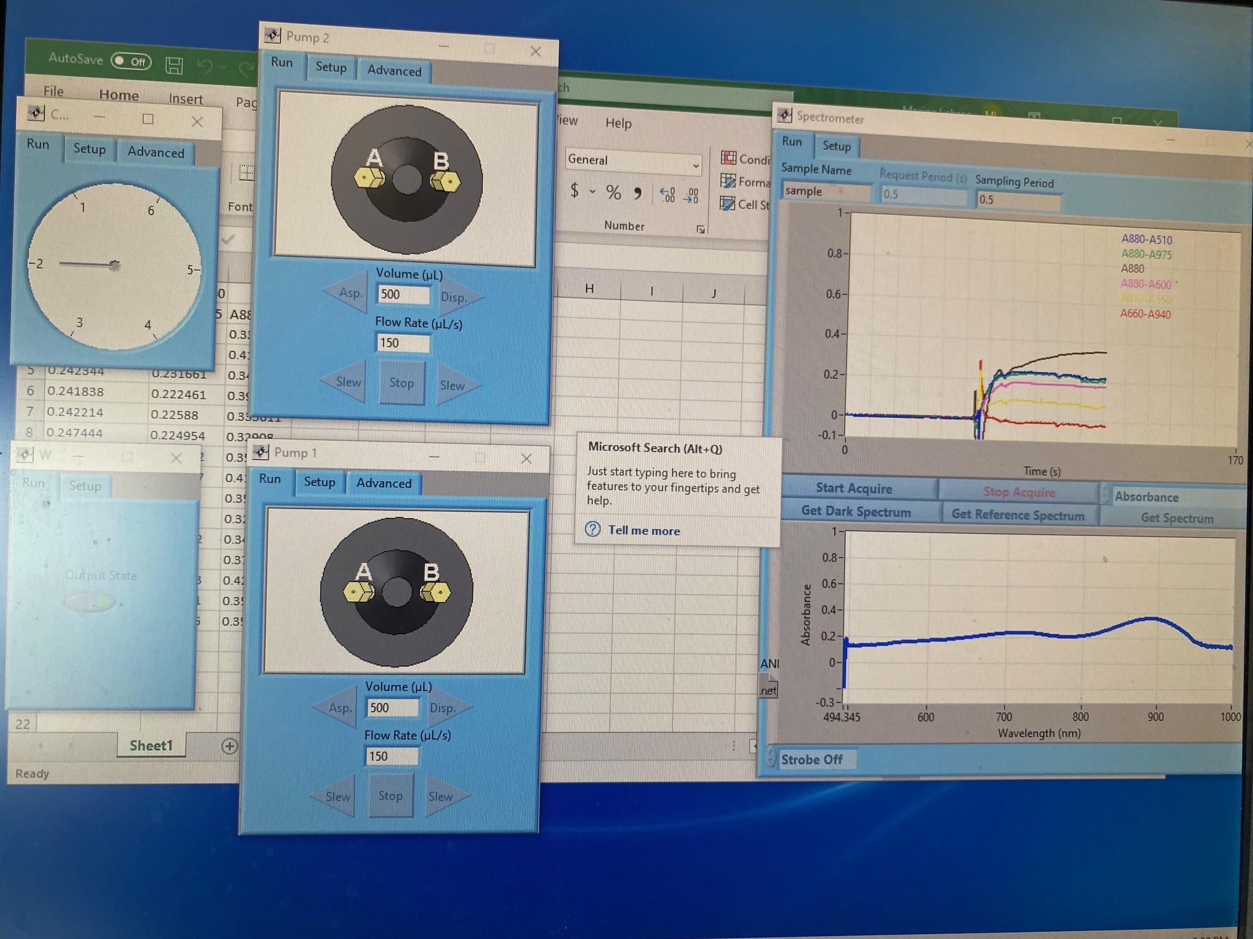
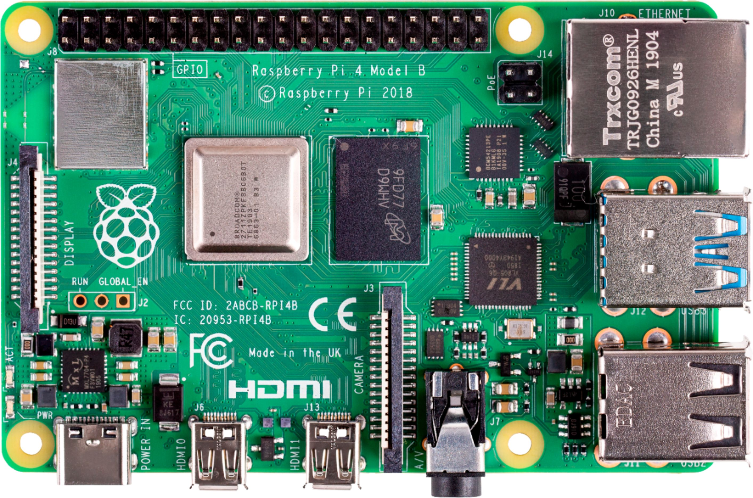
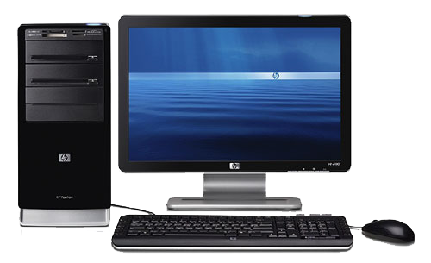
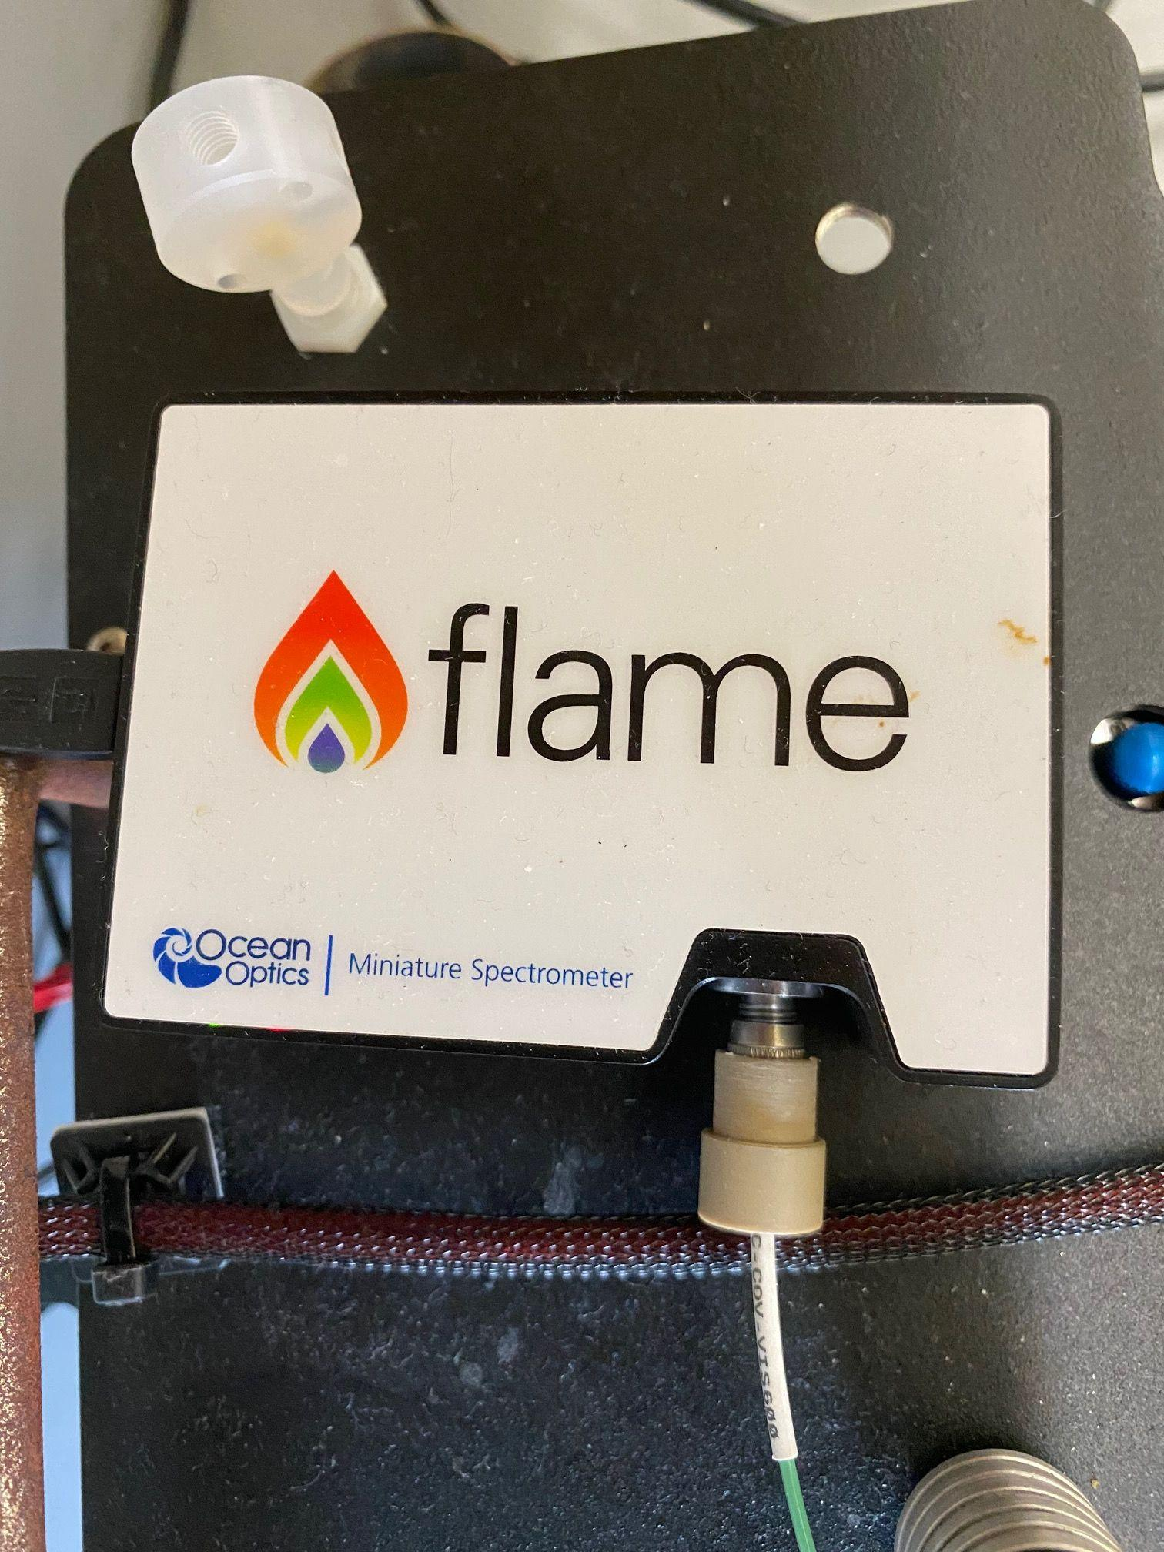
M.L.M.L. Current Design
Final Design
Tracy Hunter
Revised Design
MilliGAT pumps
5v/24v power supply
5v/24v power supply
Comm board
Aux Motor
Microcontroller
Raspberry Pi 4
Valco servo valve
Spectrometer
Flo EZ software

Slide 13
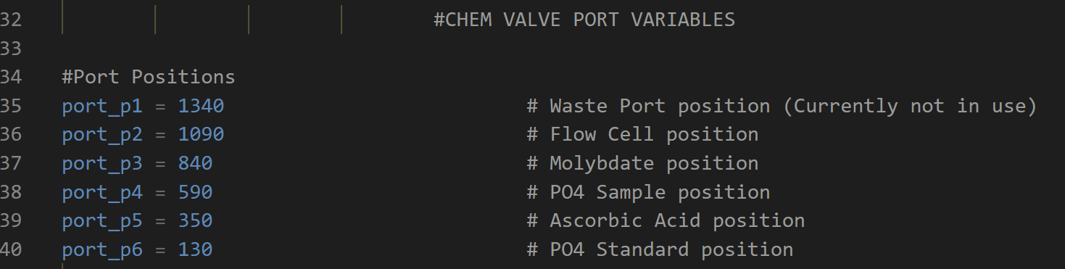
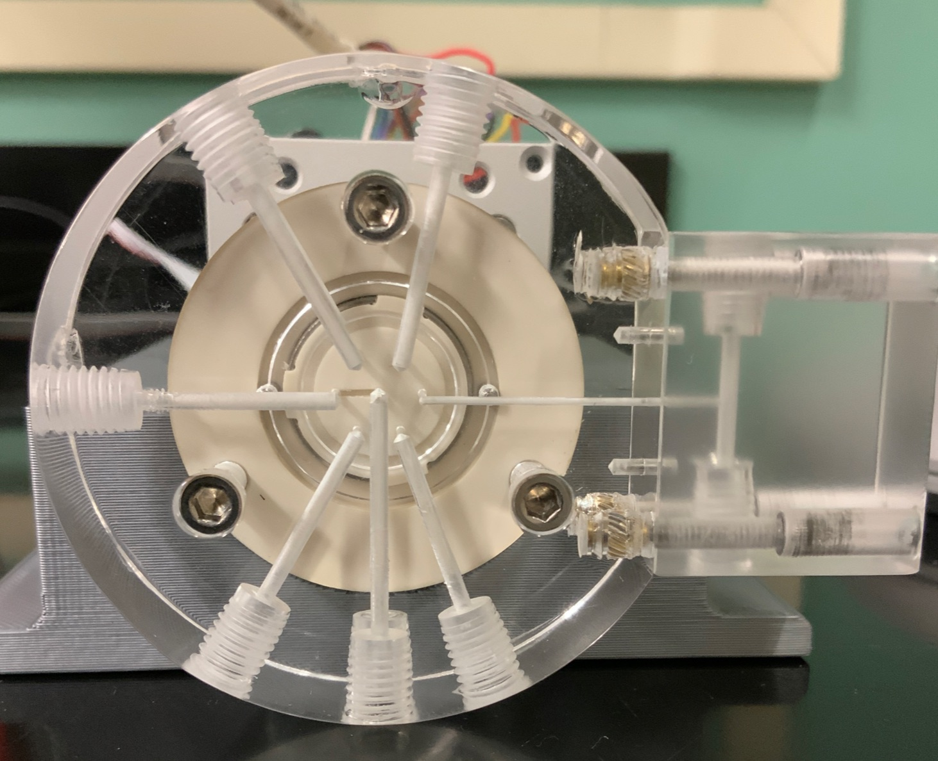
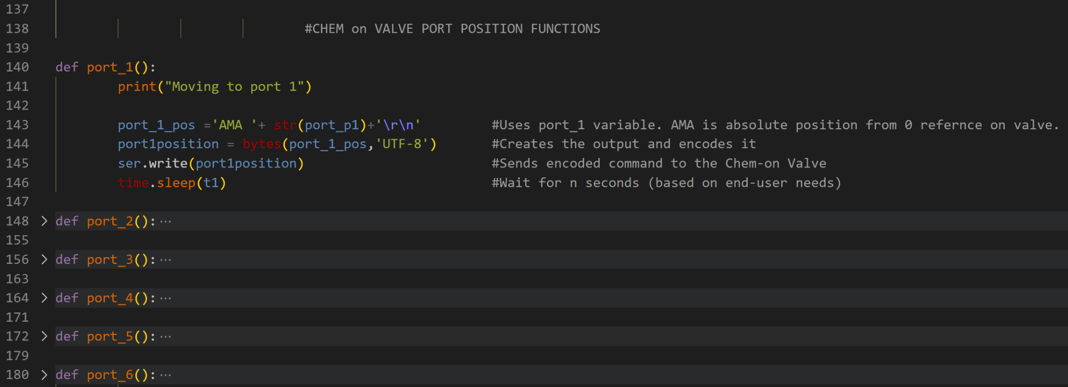
CONTROLLING THE CHEM VALVE
Tracy Hunter
3
4
2
5
6
1
Tracy Hunter
Pump ports (2X)

Slide 14

Tracy Hunter

Slide 15
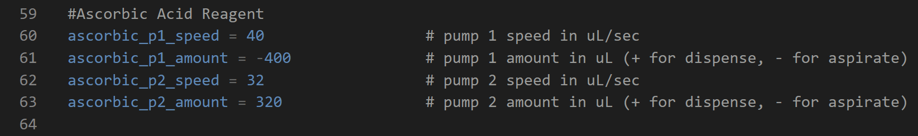
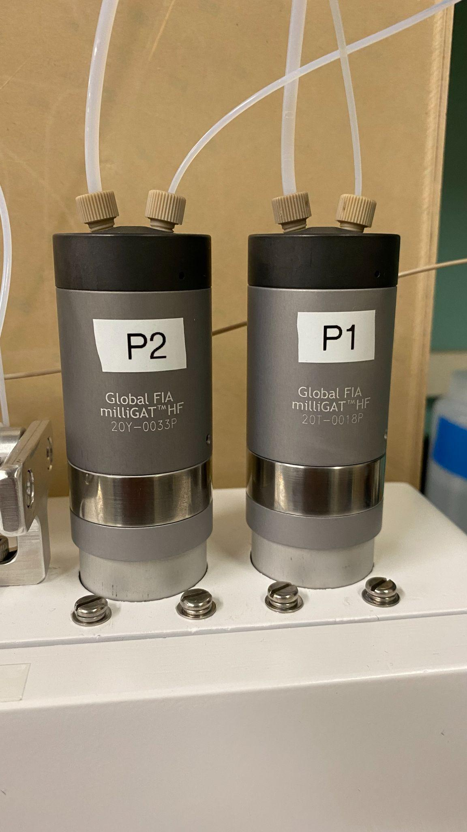
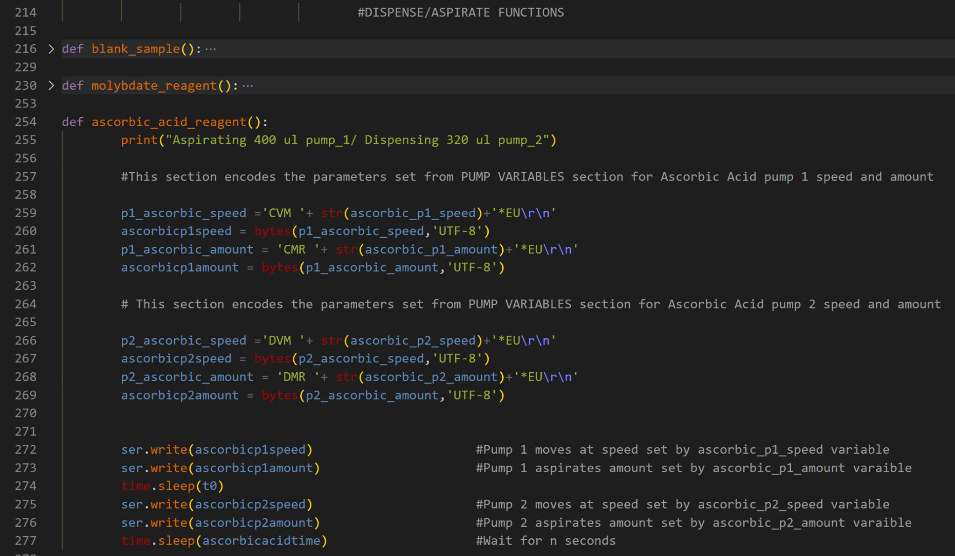
CONTROLLING THE PUMPS
Tracy Hunter

Slide 16
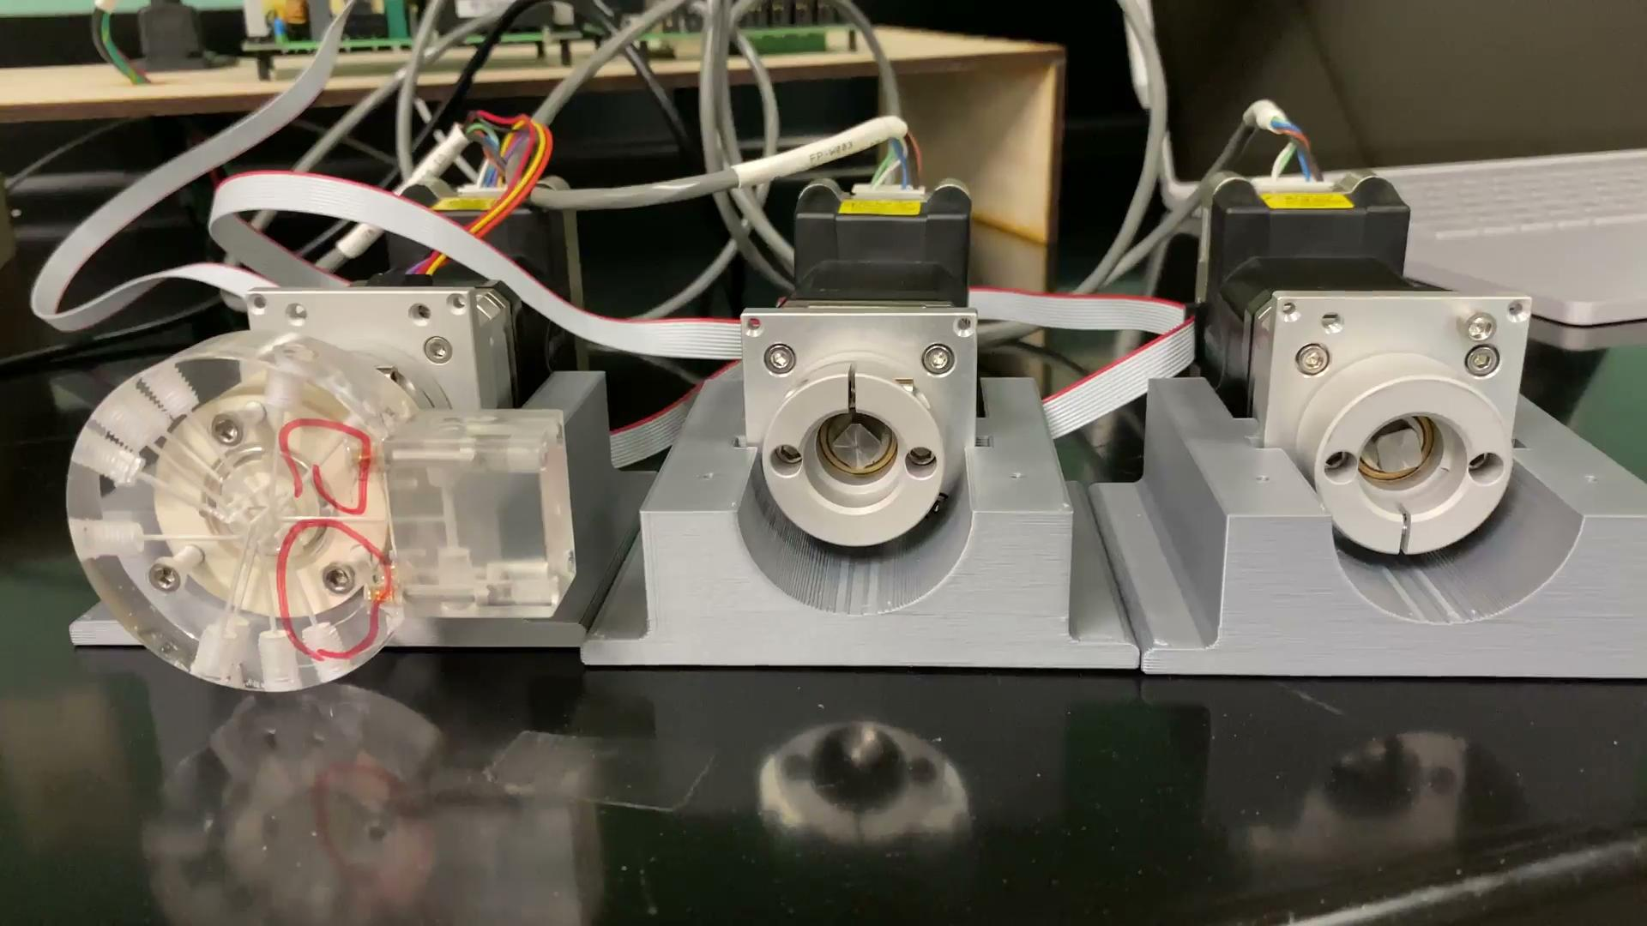

Slide 17
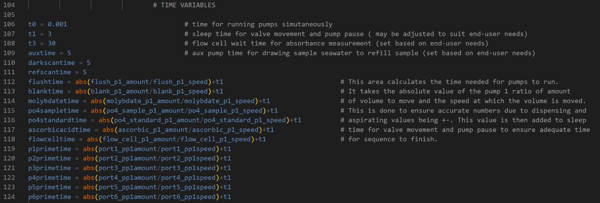
Control Over The Timing
Tracy Hunter

Slide 18
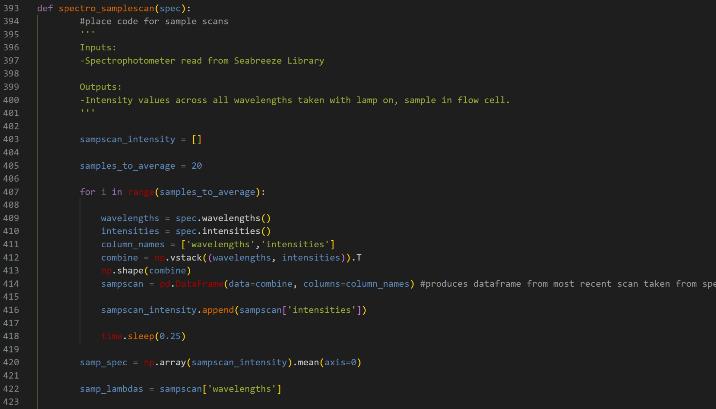
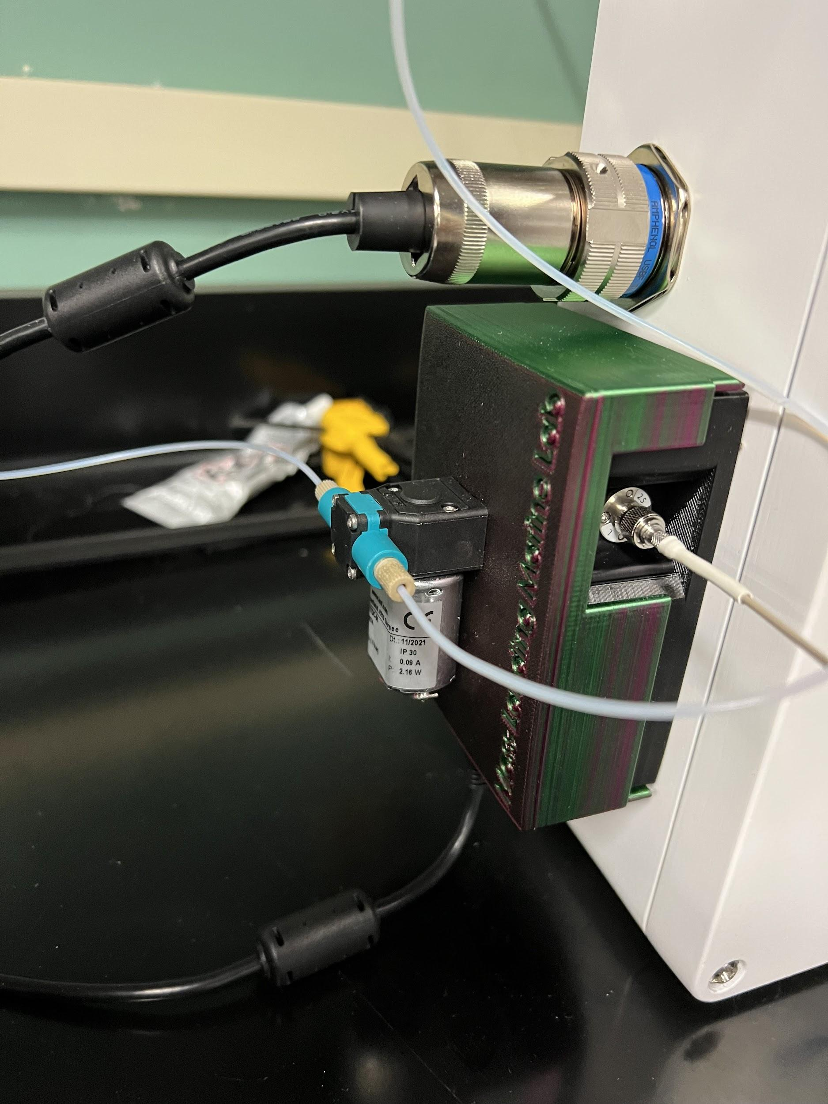
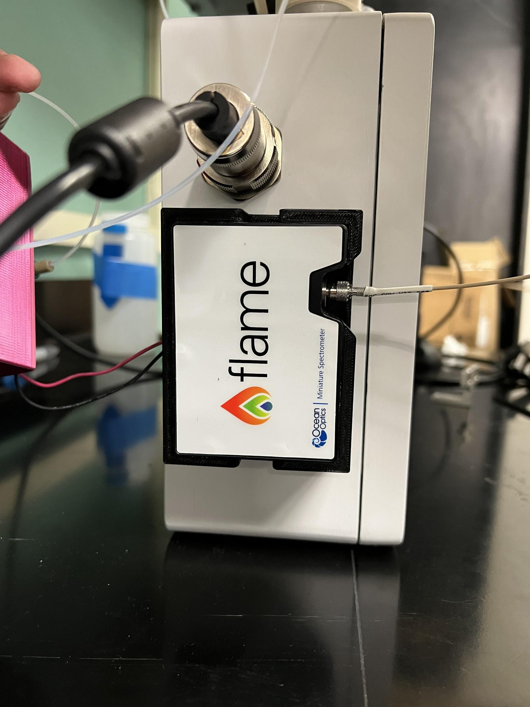
Spectrometer Control
Tim Ly

Slide 19
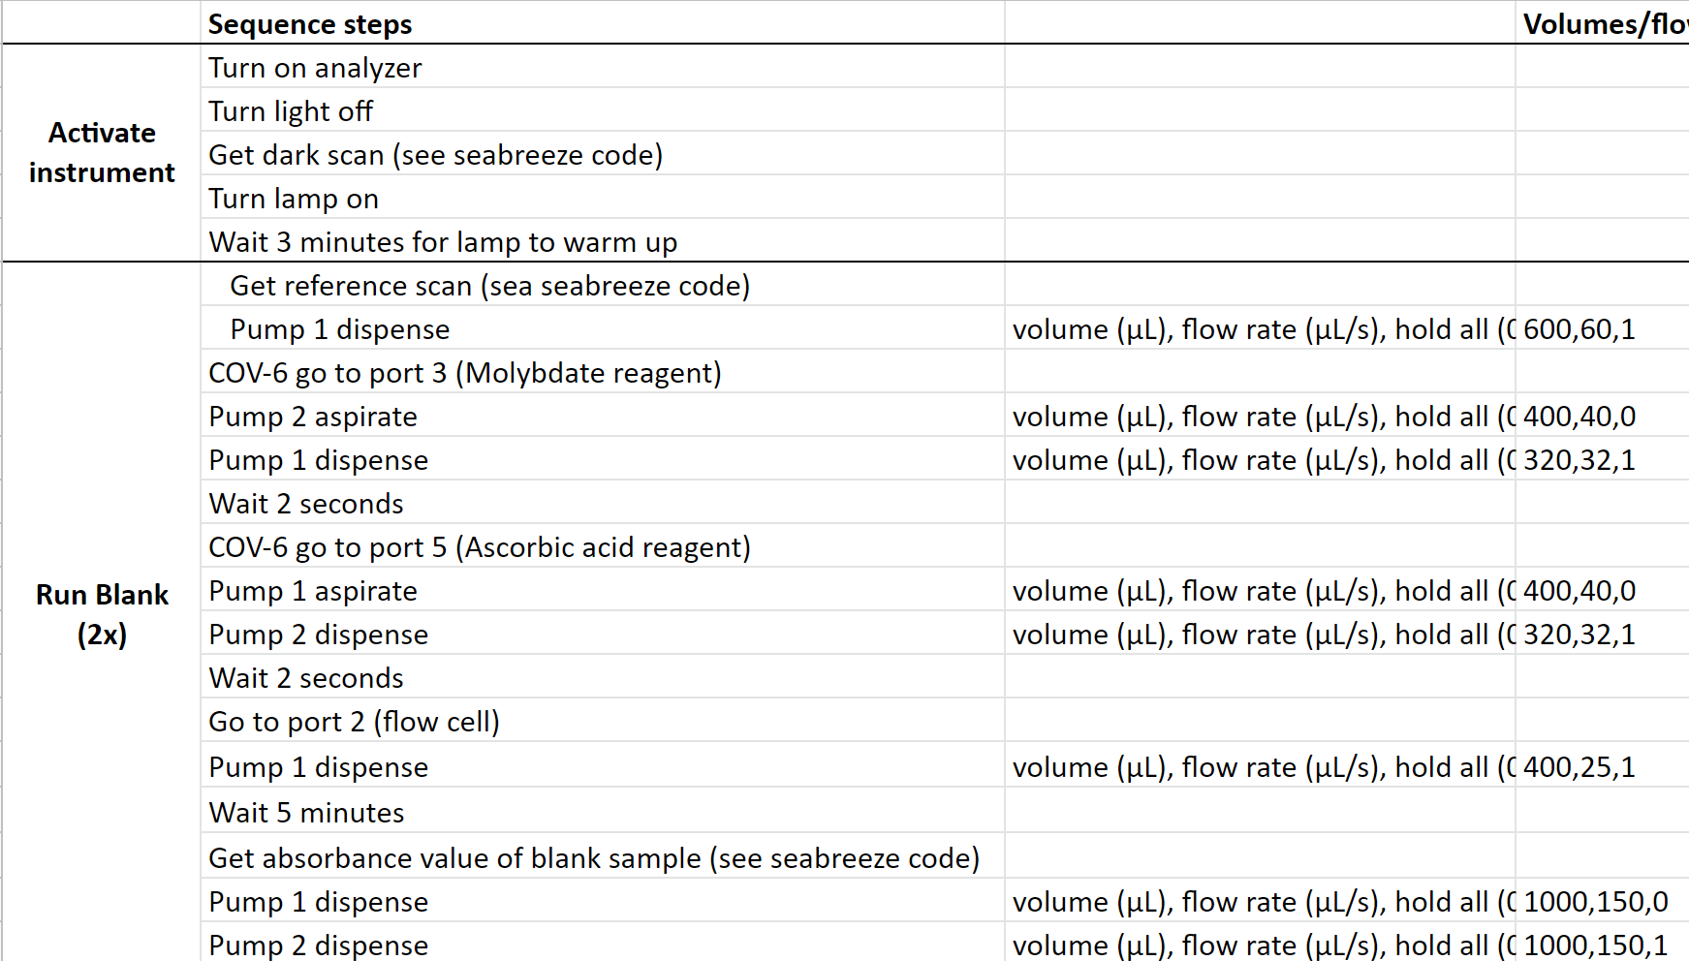
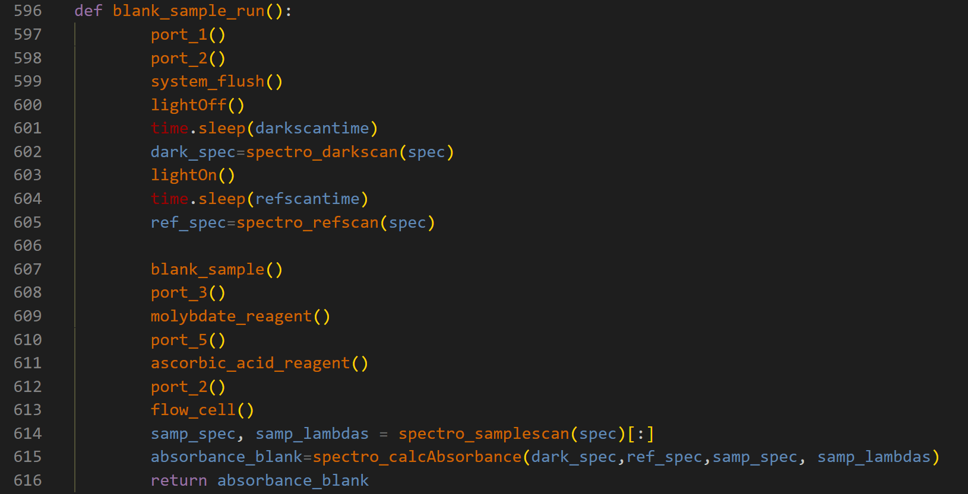
SEQUENCE OF CONTROL
Tracy Hunter
Notes:
You can delete it idc

Slide 20
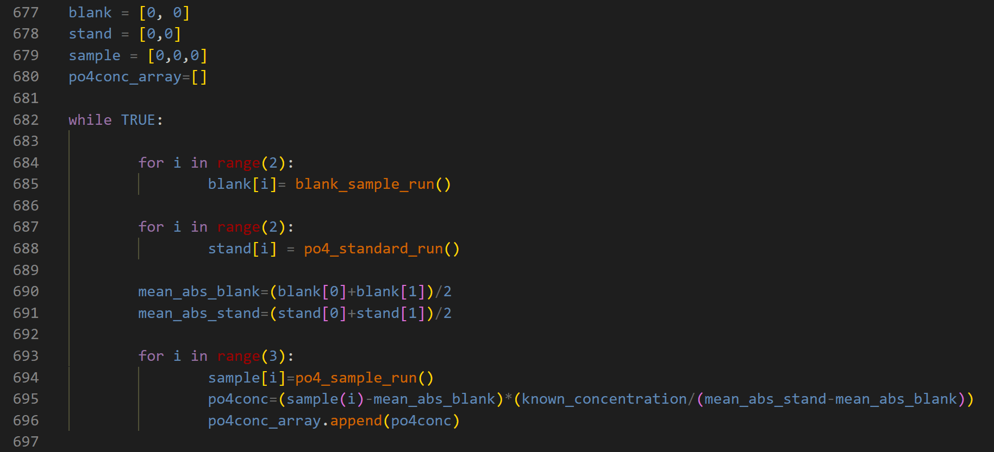
Making it Autonomous
Tim Ly
End-user assay requirement
Was to have:
Blank sample run X2
Po4 standard run X2
Po4 sample run X3
Then repeat the sequence
Data storage finalized with CMPE team

Slide 21
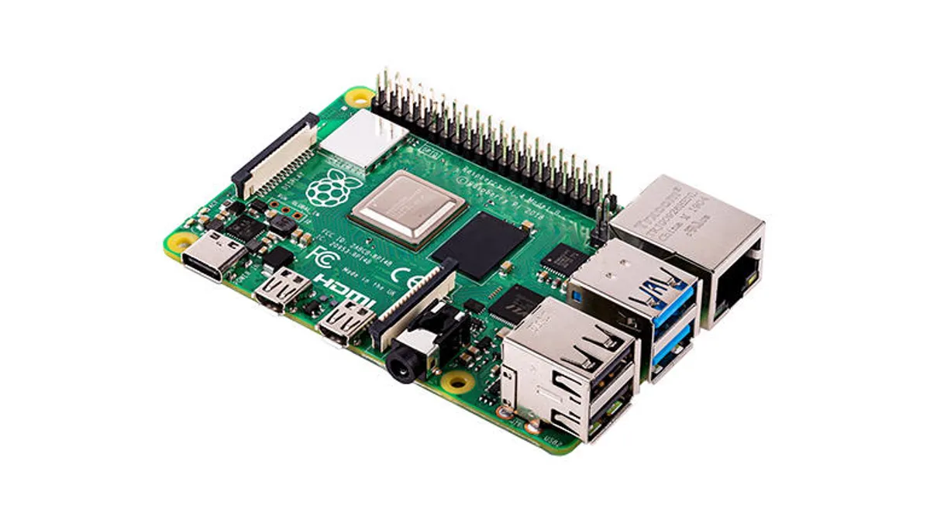
MicroComputer
Andrew Silva
Raspberry Pi 4
2GB Ram
Wifi 5
USB connectivity
Antenna
Spectrophotometer
Communication Board
https://www.zdnet.com/product/raspberry-pi-4-model-b/

Slide 22
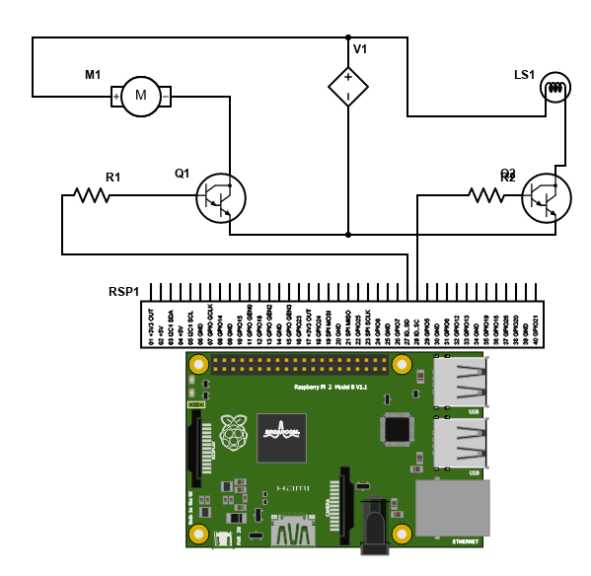
Circuit Board
Andrew Silva

Slide 23
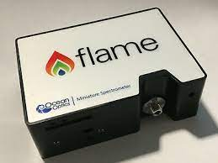
Spectrometer
Tim Ly
Usb connectivity
smooth interface with Pi 4
optic fiber passthrough
software
Python Seabreeze Library
Functions for setup, drivers, and obtaining data
Ocean Optic Flame S

Slide 24
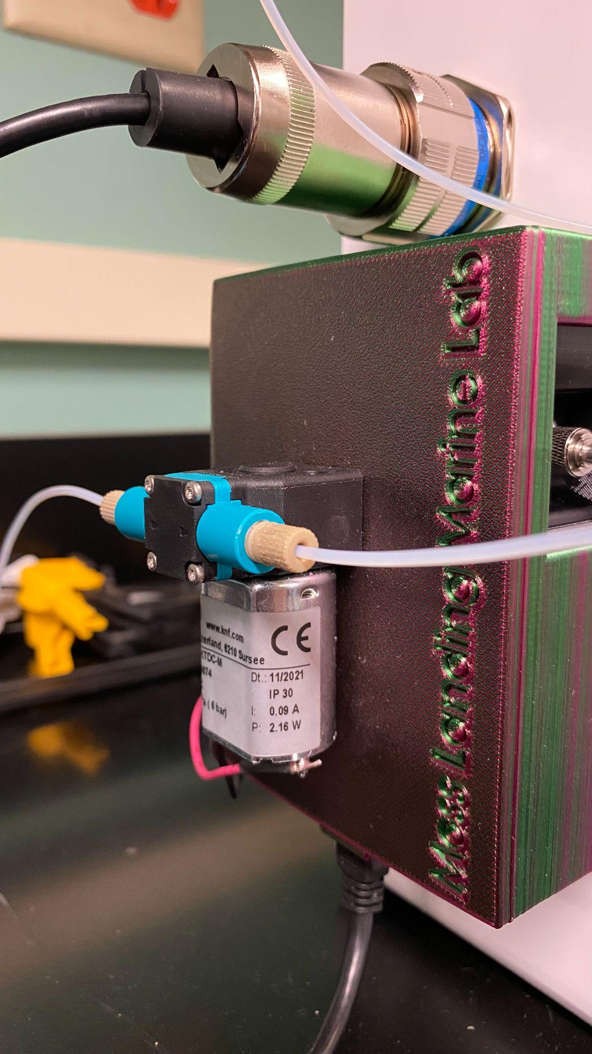
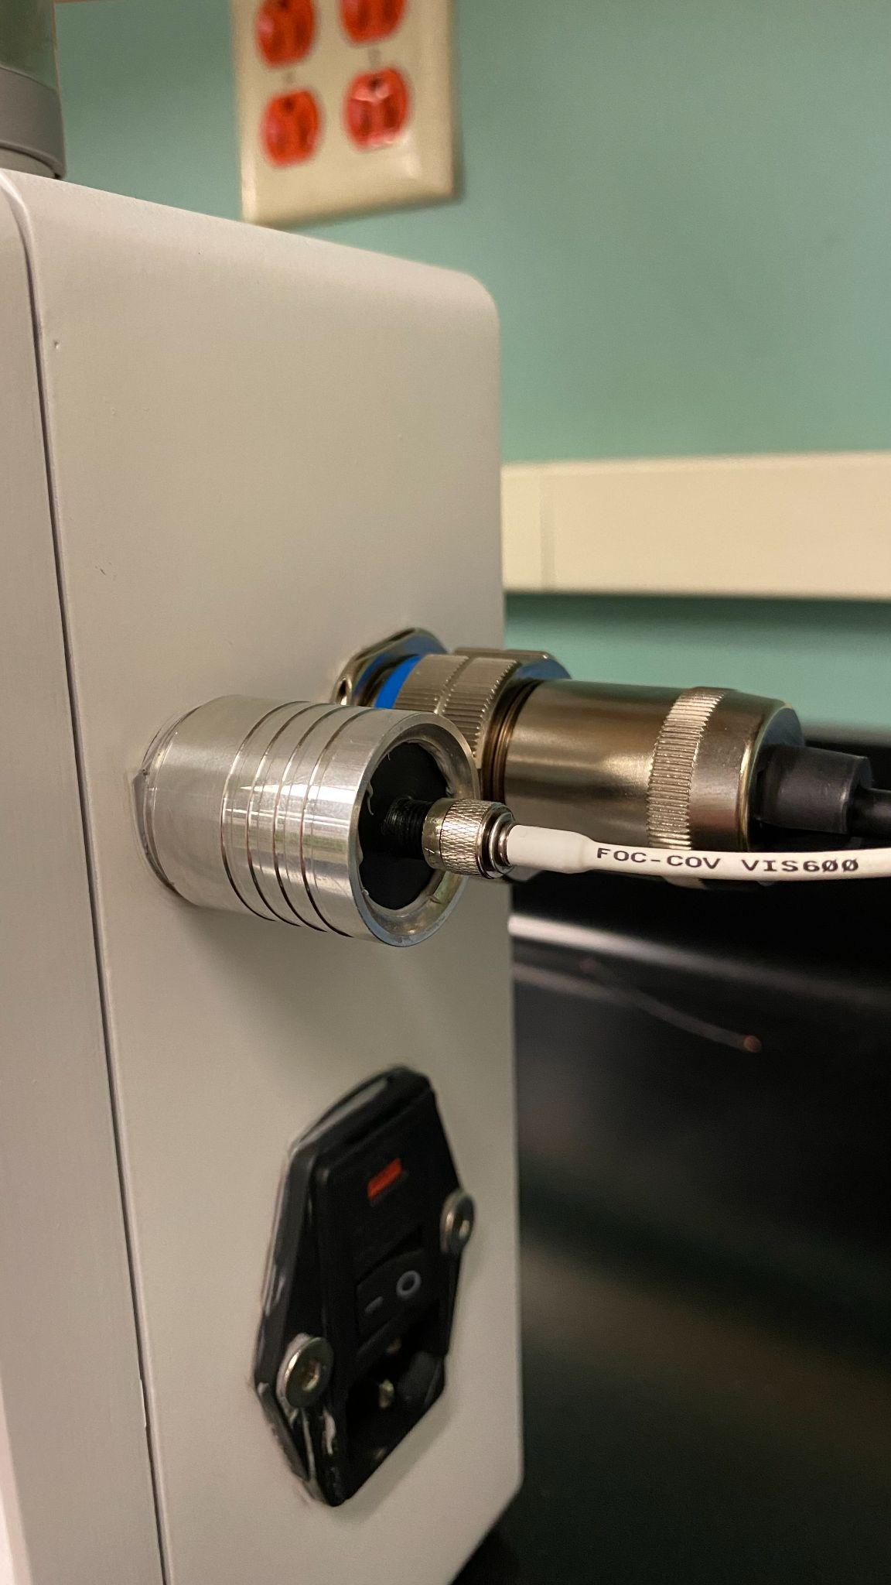
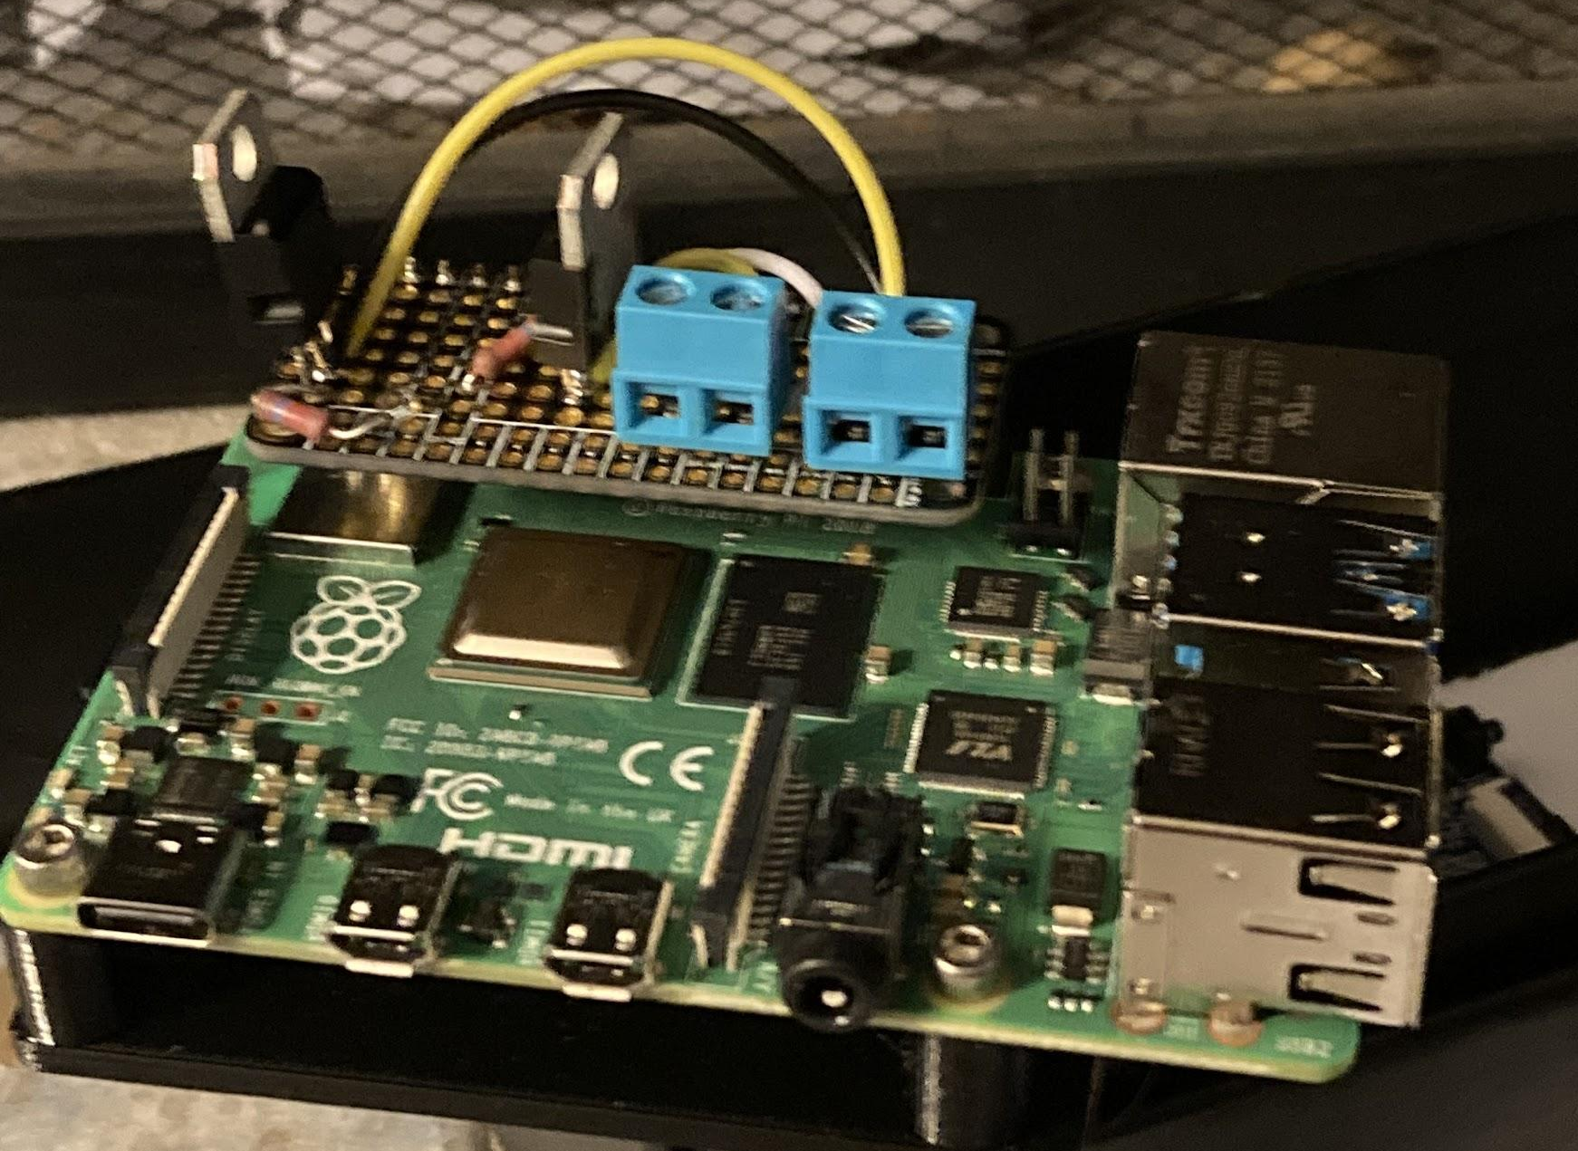
Aux pump & LED
Andrew Silva

Slide 25
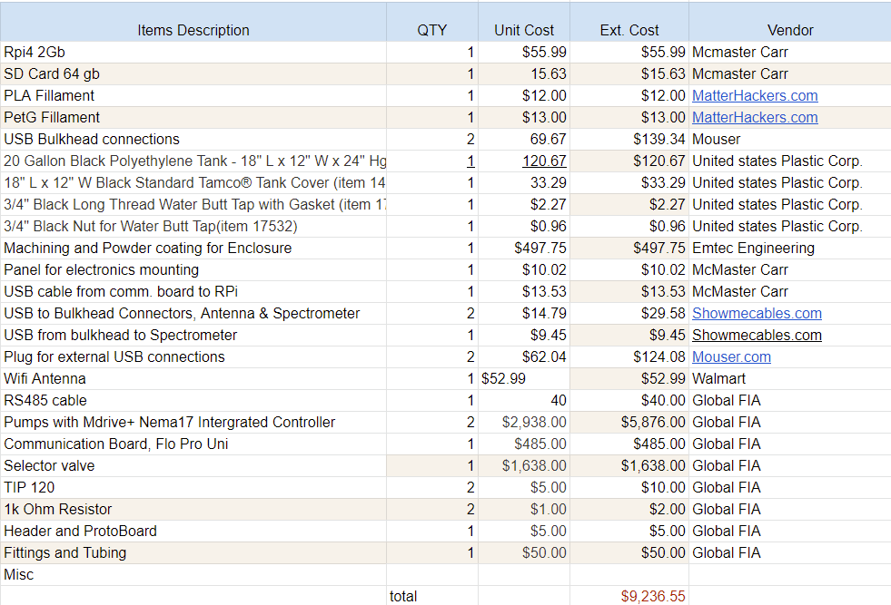
Bill of Materials
Andrew Silva

Slide 26
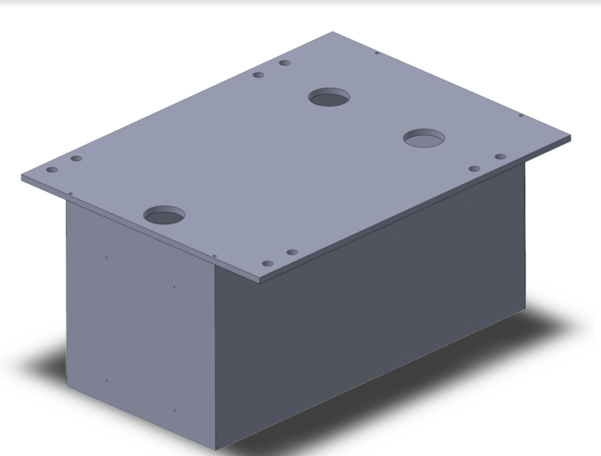
Initial Enclosure Design
Andrew Silva

Slide 27
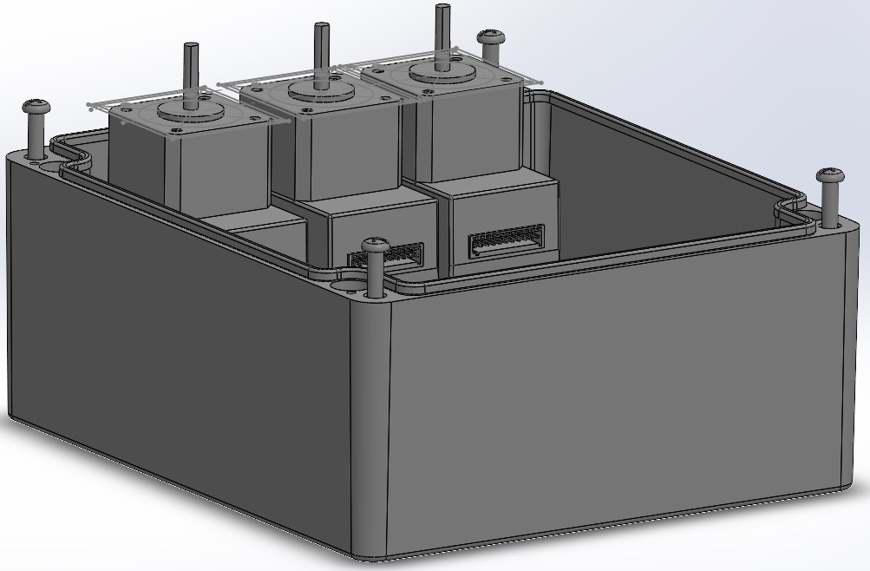
Secondary Enclosure Design
Andrew Silva

Slide 28

Secondary
Enclosure Design
Andrew Silva

Slide 29

Secondary
Enclosure Design
Andrew Silva

Slide 30


Enclosure Design Final
Andrew Silva
Andrew

Slide 31

Enclosure
Final Design
Andrew Silva

Slide 32

Andrew Silva
Enclosure, Ona Rev. D
Briefcase

Slide 33

Andrew Silva

Slide 34

Andrew Silva

Slide 35

Andrew Silva

Slide 36

Andrew Silva

Slide 37

Tracy Hunter
Reagent Storage Design
Reagent storage specs changed
Initially: Reagents would be hung from a bar
separate from the electronics housing
Scope change: reagents need to be in the dark
and possibly submerged in water to prevent reagent degradation during extended deployment time.
Internal Dimension needed
Width - 18”
Depth - 12”
Height - 22”

Slide 38



Tracy Hunter
Storage Solution
Water Butt Tap | U.S. Plastic Corp. (usplastic.com)
20 Gallon Black Polyethylene Tank - 18" L x 12" W x 24" Hgt. | U.S. Plastic Corp. (usplastic.com)

Slide 39




Storage Solution
Tracy Hunter
Casing and component placement was used to design a container that would mount to tank to hold the analyzer

Slide 40

At the Lab
Tim Ly
Ran the lab sequence
debugged
obtained readings
compared with lab unit
ran same sample in both units

Slide 41

How did we do?
Tim Ly
Obtained reasonable absorbance values of a blank sample,
a sample with a known conc. of PO4, and the sea water sample.
Calculated the concentration of phosphate within
the sea water within reason. Value of .6 umol/kg
Data qualified by the certified chemists of MLML
Highest honor of double thumbs up

Slide 42


Data samples collected
Tim Ly
Blank Sample Run
Sea Water Sample Run
PO4 Control Run

Slide 43

Andrew Silva

Slide 44

Andrew Silva

Slide 45

State of pFiona
Tim Ly
Back to the bay
Finishing setup + deployment
Reagent setup+calc
CMPE team
Finish integrating w/ CMPE program
State machine
Feedback

Slide 46

Our Journey through 195A&B
Tim Ly
Internal Teamwork
External Teamwork
Linux
Embedded System
3D Printing
Rapid Prototyping

Slide 47

Future Works
Andrew Silva
Four Optically Isolated Digital Inputs with status LEDs
Four 0 - 10V or ±10V Analog Inputs
Four Optically Isolated 4-20mA Inputs
Four Optically Isolated Open Drain Outputs, 24V/4A peak
Four 0-10V Analog Outputs
Four 4-20mA Analog Outputs
Four General Purpose LEDs
TVS Protection on all Inputs
RS485 Port
24VDC Power Supply
On Board Hardware Watchdog
On Board Resettable Fuse
Real Time Clock With Battery Backup
Pluggable Connectors 26-16 AWG wires
sequentmicrosystems.com

Slide 48

Chip Shortage:
Andrew Silva
Orange Pi PC+
Two USB2 2.0 ports + One USB 3.0
Built in WiFi
ARMBIAN OS (Modified Debian)
Quad - core ARM A7 chipset
1 gb Ram DDR3
8 gb onboard eMMC
DC Barrel 2.5mm power

Slide 49
ACKNOWLEDGEMENTS
Sponsors: Moss Landing Marine Lab Team
Maxime Grand
Marine Lebrec
CMPE Team:
Hoanan Wang
Aakanksha Gupta
Advisors: San Jose State University Team
Crystal Han
Farzan Kazimafar
Ed Cydzik
Special Thanks:
Lin Jiang
Winncy Du
Buff Furman
Eric Swartz
Ryan Sands

Slide 50
References
Ibnul, N. K., & Tripp, C. P. (2021). “A solventless method for detecting trace level phosphate and
arsenate in water using a transparent membrane and visible spectroscopy”. Talanta
(Oxford), 225, 122023–122023. https://doi.org/10.1016/j.talanta.2020.122023
Legiret, F. Sieben, V. Woodward, E. Bey, S. Mowlem, M. Connelly, D. Achterberg, E. (2013) “A High performance microfluidic
analyser for phosphate measurements in marine waters using vanadomolybdate method”. Talanta (Oxford), 116, ISSN 0039-9140, https://doi.org/10.1016/j.talanta.2013.05.004.
Elkhorn Slough Water Quality Scorecard. (n.d.). Water.elkhornslough.org. Retrieved October 6, 2021, from http://water.elkhornslough.org/
Farm & Ranch Runoff And Drainage | RCD Of Monterey County. (n.d.). Resource Conservation District of Monterey County. Retrieved October 6, 2021, from
https://www.rcdmonterey.org/farm-ranch-runoff-and-drainage
‌

